Slide 1
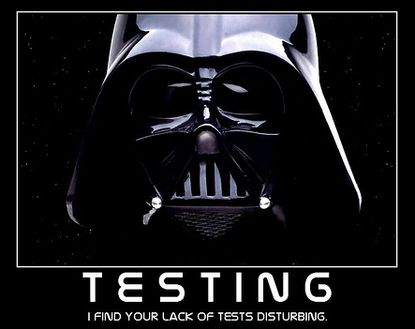
Unit Testing with Visual Studio Team Test
Introduction to Unit Testing
Svetlin Nakov
Telerik Corporation
www.telerik.com

Slide 2
Table of Contents
Unit Testing Fundamentals
Some facts
Why unit tests?
Unit Testing Patterns
Visual Studio Team Test Testing Framework
Attributes, Assertions, Expected Exceptions
Code Coverage
Unit Testing Best Practices

Slide 3
What is Unit Testing?

Slide 4
Unit Test – Definition
A unit test is a piece of code written by a developer that exercises a very small, specific area of functionality of the code being tested.
“Program testing can be used to show the presence of bugs, but never to show their absence!”
Edsger Dijkstra, [1972]

Slide 5
Manual Testing
You have already done unit testing
Manually, by hand
Manual tests are less efficient
Not structured
Not repeatable
Not on all your code
Not easy to do as it should be

Slide 6
Unit Test – Example
int Sum(int[] array)
{
sum = 0;
for (int i=0; i<array.Length; i++)
sum += array[i];
return sum;
}
void TestSum()
{
if (Sum(new int[]{1,2}) != 3)
throw new TestFailedException("1+2 != 3");
if (Sum(new int[]{-2}) != -2)
throw new TestFailedException("-2 != -2");
if (Sum(new int[]{}) != 0)
throw new TestFailedException("0 != 0");
}

Slide 7
Unit Testing – Some Facts
Tests are specific pieces of code
Unit testing framework is needed
Visual Studio Team Test
NUnit
MbUnit
Unit tests are written by developers, not by QA engineers
Unit tests are released into the code repository along with the code they test

Slide 8
Unit Testing – More Facts
All classes should be tested
Test anything that could have bugs
All methods should be tested
Trivial code may be omitted
E.g. property getters and setters
Ideally all unit tests should pass before check-in into the source control repository

Slide 9
Why Unit Tests?
Unit tests dramatically decrease the number of defects in the code
Unit tests improve design
Unit tests are good documentation
Unit tests reduce the cost of change
Unit tests allow refactoring
Unit tests decrease the defect-injection rate due to refactoring / changes

Slide 10
Code and Test vs. Test Driven Development

Slide 11
Unit Testing Approaches
"Code and Test" approach
Classical approach
"Test First" approach
Test driven development (TDD)

Slide 12
Code and Test Approach
Write code
Write unit test
Run and succeed
Time flow

Slide 13
Test Driven Development (TDD)
Create a test list
Pick а test
Write test
Compile and fail
Write enough code to compile
Run test and fail
Write code to pass test
Time flow
Remove duplication

Slide 14
Why Test Driven Development?
Helps find design issues early and avoids rework
Writing code to satisfy a test is a focused activity – less chance of error
Tests will be a more comprehensive than when written after code

Slide 15
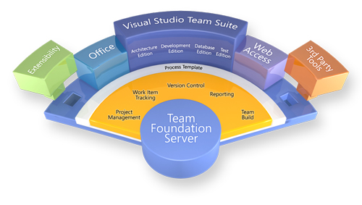
Unit Testing Frameworks and Visual Studio Team Test

Slide 16
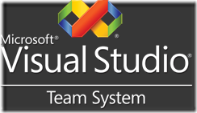
Unit Testing Frameworks
JUnit
The first popular unit testing framework
Based on Java
Similar frameworks have been developed for a broad range of computer languages
NUnit – for C# and all .NET languages
cppUnit, jsUnit, PhpUnit, PerlUnit, ...
Visual Studio Team Test (VSTT)
Developed by Microsoft, integrated in VS

Slide 17
Visual Studio Team Test – Features
Team Test (TT) is very well integrated with Visual Studio
Create test projects and unit tests
Execute unit tests
View execution results
View code coverage
Located in the assembly Microsoft.VisualStudio.QualityTools.UnitTestFramework.dll

Slide 18
Visual Studio Team Test – Attributes
Test code is annotated using custom attributes
[TestClass] – denotes a class holding unit tests
[TestMethod] – denotes a unit test method
[ExpectedException] – test causes an exception
[Timeout] – sets a timeout for test execution
[Ignore] – temporary ignored test case
[ClassInitialize], [ClassCleanup] – setup / cleanup logic for the testing class
[TestInitialize], [TestCleanup] – setup / cleanup logic for each test case

Slide 19
Assertions
Predicate is a true / false statement
Assertion is a predicate placed in the program code
Indicates that the developer thinks that the predicate is always true at that place
If an assertion fails, the method call does not return and an error is reported
Example:
Assert.AreEqual(expectedValue, actualValue,
"Error message.");

Slide 20
VSTT – Assertions
Assertions check condition and throw exception if condition is not satisfied
Comparing values
AreEqual(expected value, calculated value [,message]) – compare two values for equality
Comparing objects
AreSame(expected object, current object [,message]) – compare object references

Slide 21
VSTT – Assertions (2)
Checking for null value
IsNull(object [,message])
IsNotNull(object [,message])
Conditions
IsTrue(condition)
IsFalse(condition)
Forced test fail
Fail(message)

Slide 22
The 3A Pattern
Arrange all necessary preconditions and inputs
Act on the object or method under test
Assert that the expected results have occurred
[TestMethod]
public void TestDeposit()
{
BanckAccount account = new BanckAccount();
account.Deposit(125.0);
account.Deposit(25.0);
Assert.AreEqual(150.0, account.Balance,
"Balance is wrong.");
}

Slide 23
VSTT – Example
public class Account
{
private decimal balance;
public void Deposit(decimal amount)
{
this.balance += amount;
}
public void Withdraw(decimal amount)
{
this.balance -= amount;
}
public void TransferFunds(
Account destination, decimal amount)
{ ... }
public decimal Balance
{ ... }
}

Slide 24
VSTT – Example (2)
using Microsoft.VisualStudio.TestTools.UnitTesting;
[TestClass]
public class AccountTest
{
[TestMethod]
public void TransferFunds()
{
Account source = new Account();
source.Deposit(200.00M);
Account dest = new Account();
dest.Deposit(150.00F);
source.TransferFunds(dest, 100.00F);
Assert.AreEqual(250.00F, dest.Balance);
Assert.AreEqual(100.00F, source.Balance);
}
}

Slide 25
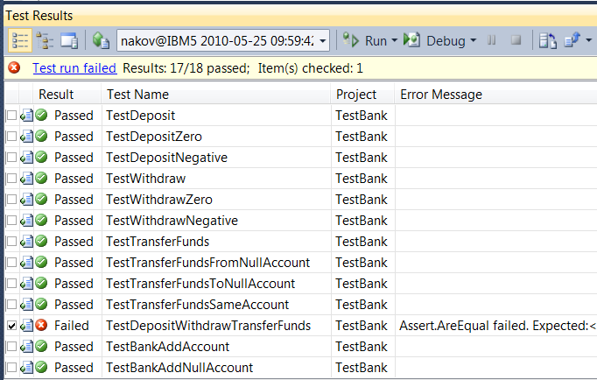
VSTT – Screenshot

Slide 26
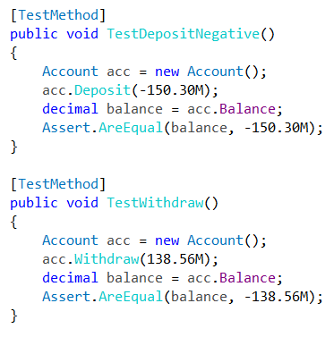
Visual Studio Team Test
Live Demo

Slide 27
Unit Testing Best Practices

Slide 28
Naming Standards for Unit Tests
The test name should express a specific requirement that is tested
Usually prefixed with [Test]
E.g. TestAccountDepositNegativeSum()
The test name should include
Expected input or state
Expected result output or state
Name of the tested method or class

Slide 29
Naming Standards for Unit Tests – Example
Given the method:
with requirement to ignore numbers greater than 100 in the summing process
The test name should be:
Sum_NumberIgnoredIfGreaterThan100
public int Sum(params int[] values)

Slide 30
When Should a Test be Changed or Removed?
Generally, a passing test should never be removed
These tests make sure that code changes don’t break working code
A passing test should only be changed to make it more readable
When failing tests don’t pass, it usually means there are conflicting requirements

Slide 31
When Should a Test be Changed or Removed? (2)
Example:
New features allows negative numbers
[ExpectedException(typeof(Exception),
"Negatives not allowed")]
void Sum_FirstNegativeNumberThrowsException()
{
Sum (-1,1,2);
}

Slide 32
When Should a Test be Changed or Removed? (3)
New developer writes the following test:
Earlier test fails due to a requirement change
void Sum_FirstNegativeNumberCalculatesCorrectly()
{
int sumResult = sum(-1, 1, 2);
Assert.AreEqual(2, sumResult);
}

Slide 33
When Should a Test be Changed or Removed? (4)
Two course of actions:
Delete the failing test after verifying if it’s valid
Change the old test:
Either testing the new requirement
Or test the older requirement under new settings

Slide 34
Tests Should Reflect Required Reality
What’s wrong with the following test?
A failing test should prove that there is something wrong with the production code
Not with the unit test code
int Sum(int a, int b) –> returns sum of a and b
public void Sum_AddsOneAndTwo()
{
int result = Sum(1,2);
Assert.AreEqual(4, result, "Bad sum");
}

Slide 35
What Should Assert Messages Say?
Assert message in a test is one of the most important things
Tells us what we expected to happen but didn’t, and what happened instead
Good assert message helps us track bugs and understand unit tests more easily
Example:
"Withdrawal failed: accounts are not supposed to have negative balance."

Slide 36
What Should Assert Messages Say? (2)
Express what should have happened and what did not happen
“Verify() did not throw any exception”
“Connect() did not open the connection before returning it”
Do not:
Provide empty or meaningless messages
Provide messages that repeat the name of the test case

Slide 37
Avoid Multiple Asserts in a Single Unit Test
void Sum_AnyParamBiggerThan1000IsNotSummed()
{
Assert.AreEqual(3, Sum(1001, 1, 2);
Assert.AreEqual(3, Sum(1, 1001, 2);
Assert.AreEqual(3, Sum(1, 2, 1001);
}
Avoid multiple asserts in a single test case
If the first assert fails, the test execution stops for this test case
Affect future coders to add assertions to test rather than introducing a new one

Slide 38
Unit Testing – The Challenge
The concept of Unit Testing has been around for many years
New methodologies in particular XP, have turned unit testing into a cardinal foundation of software development
Writing good & effective Unit Tests is hard!
This is where supporting integrated tools and suggested guidelines enter the picture
The ultimate goal is tools that generate unit tests automatically

Slide 39
Unit Testing with Visual Studio Team Test
?
?
?
?
?
Questions?
?
?
?
?
?
http://academy.telerik.com

Slide 40
Exercises
Write two classes: Student and Course. Students should have name and faculty number. Name can not be empty and unique faculty number is between 10000 and 99999. Each course contains a set of students. Students in a course should be less than 30 and can join and leave courses.
Write VSTT tests for these two classes
Use 2 class library projects in Visual Studio: School.csproj and TestSchool.csproj
Execute the tests using Visual Studio and check the code coverage. Can you achieve code coverage of at least 95%?

Slide 41
Exercises (2)
Implement the insertion sort algorithm and write unit tests for it.
Implement the "Bulls and Cows" game (console variant) and write unit tests for it. See the file Bulls-and-Cows.doc.

Slide 42
Useful Links
A Unit Testing Walkthrough with Visual Studio Team Test – http://msdn.microsoft.com/en-us/library/ms379625(VS.80).aspx
NUnit – www.nunit.org
Extreme Programming – www.extremeprogramming.org
XP Programming – www.xprogramming.com
Advanced Unit Testing – www.codeproject.com/csharp/autp1.asp

