Slide 1
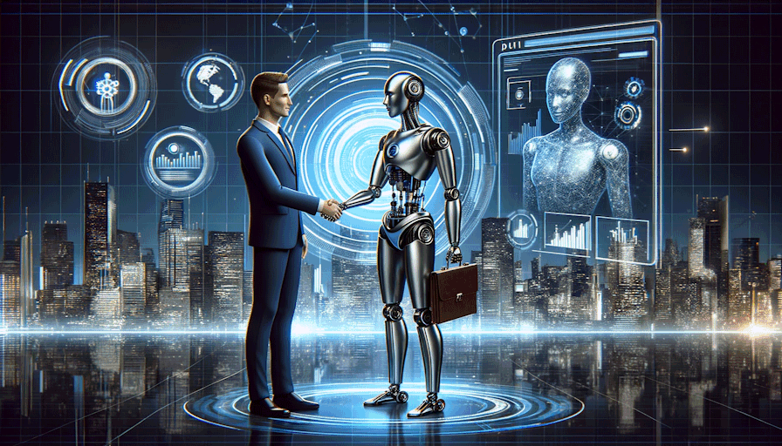
AI for Business and Startups
Examples of Creativity, Daily Tasks, Marketing, Data Analysis with ChatGPT, Bard, Claude, DALL-E
Svetlin Nakov, PhD
Co-Founder, Innovations Director @ SoftUni
https://softuni.bg
https://nakov.com

Slide 2
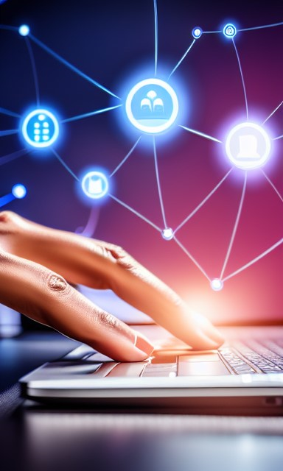
Agenda
Artificial Intelligence is already here!
AI Tools for Business: Where is AI Used?
ChatGPT and Bard in Daily Tasks
ChatGPT and Bard for Creativity
ChatGPT and Bard for Marketing
ChatGPT for Data Analysis
DALL-E for Image Generation
Runway ML for Video Generation

Slide 3
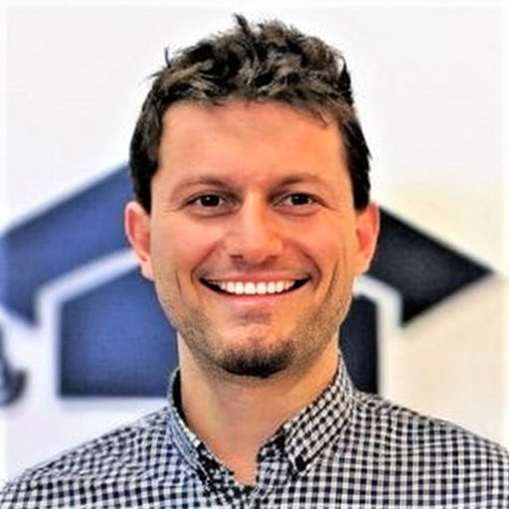
Svetlin Nakov, PhD
Software engineer, tech trainer, entrepreneur, speaker, author of 16 books (before gen. AI era)
nakov.com
4 successful tech education projects
National Academy for Software Development (NASD) – 2004
Telerik Software Academy – 2009
SoftUni (The Software University) – 2014
Tech High School "SoftUni Svetlina" – 2018

Slide 4
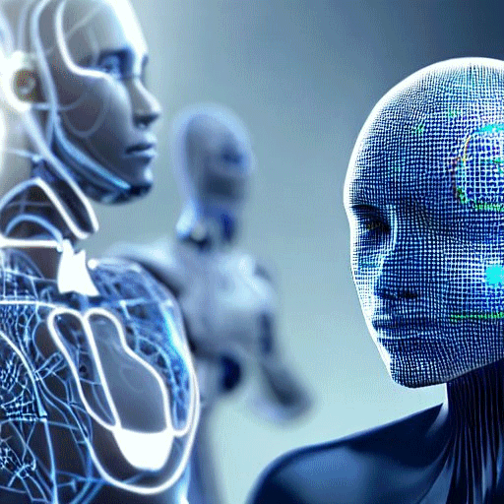
Artificial Intelligence is Already Here!
AI technologies have left the research labs and are now everywhere
ChatGPT, Bard and Claude tend to replace the Internet search engines
Midjourney, DALL-E, Stable Diffusion tend to replace / upgrade the photographers, designers and visual artists
Businesses now use AI on a daily basis
Digital transformation → AI transformation
Businesses who don't adopt AI, will fall behind their competitors

Slide 5
Where is AI Used?
Daily work tasks: research company / product, writing emails, writing ads, writing offers, writing simple contracts, ...
Creativity: brainstorming, inventing business ideas, brand identity, marketing plan, campaigns, website, illustrations, ...
Marketing: campaign ideas, generating content, articles, emails, social media posts, ads, images, videos, ...
Data analysis: summary, analysis and search in large documents text summarization, language translation, financial analysis
Education, sales, research, business planning, support, ...

Slide 6
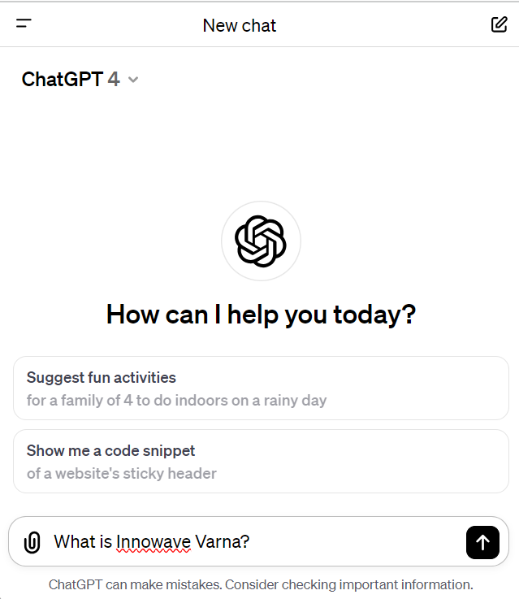
ChatGPT: The Market Leader in Gen AI
ChatGPT (https://chat.openai.com)
ChatGPT == AI chatbot, who understands and generates human-like text, answers questions, solves problems, generates content
Market leader in the generative AI models
ChatGPT-3.5: free, fast, less capable model
ChatGPT-4: paid, more powerful, slower
Internet browsing for augmented answers
Text-to-image generation with DALL-E
Supports documents and images as input

Slide 7
AI for Daily Business Tasks

Slide 8
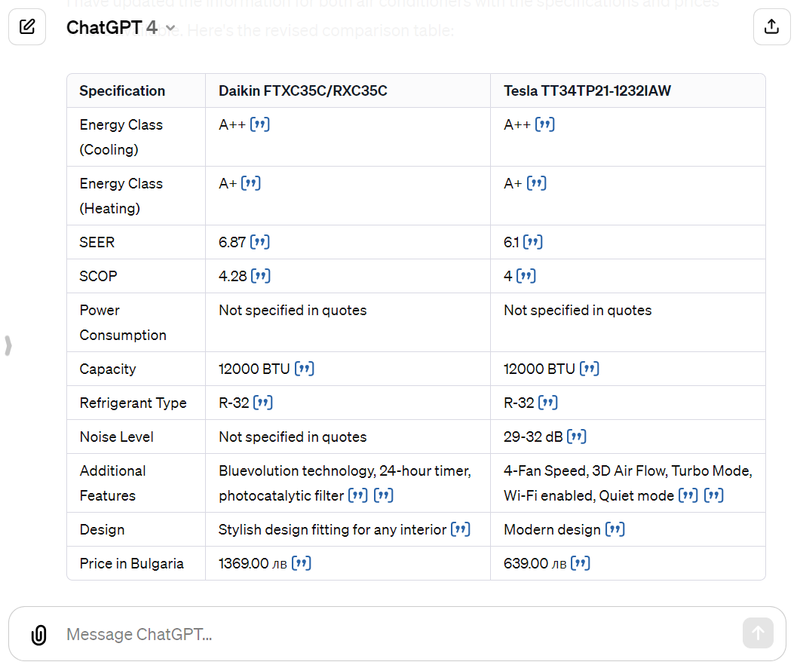
ChatGPT in Daily Tasks: Compare Products
Compare in a table these air conditioners:
1) Daikin FTXC35C/RXC35C
2) Tesla TT34TP21-1232IAW
Tell me about their major tech specs, energy efficiency, etc.
Find and compare the prices for Bulgaria.
Find reviews and estimate the reputation of both products.
https://chat.openai.com/share/78dc132f-9034-4da1-9073-df199b25cba8

Slide 9
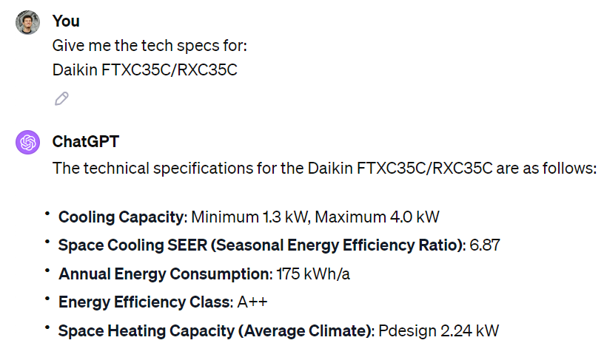
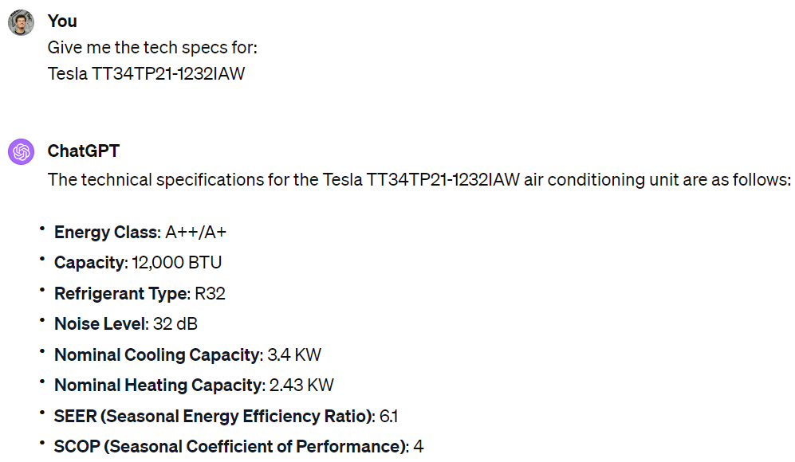
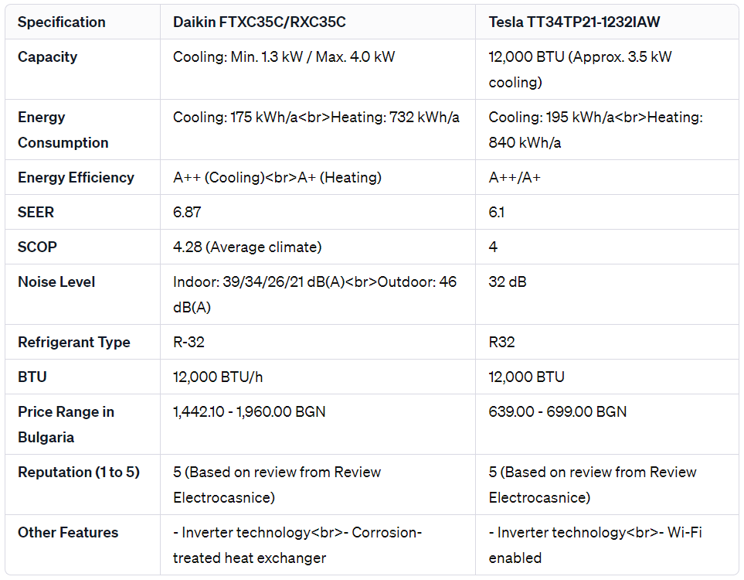
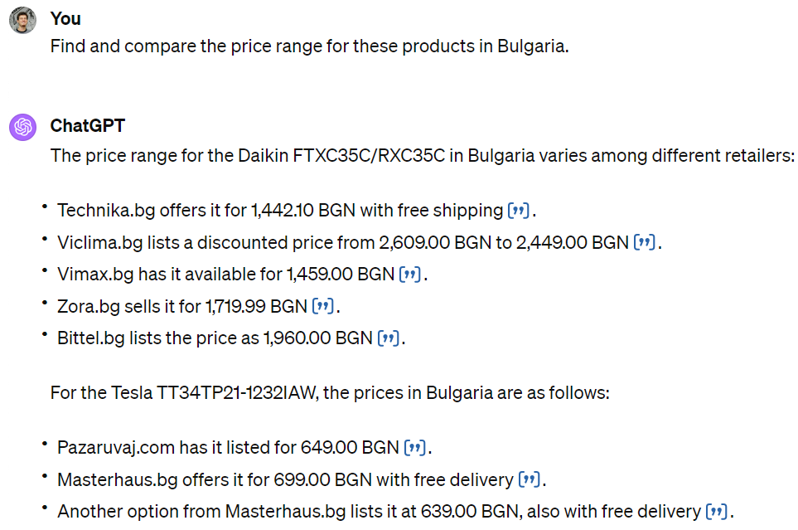
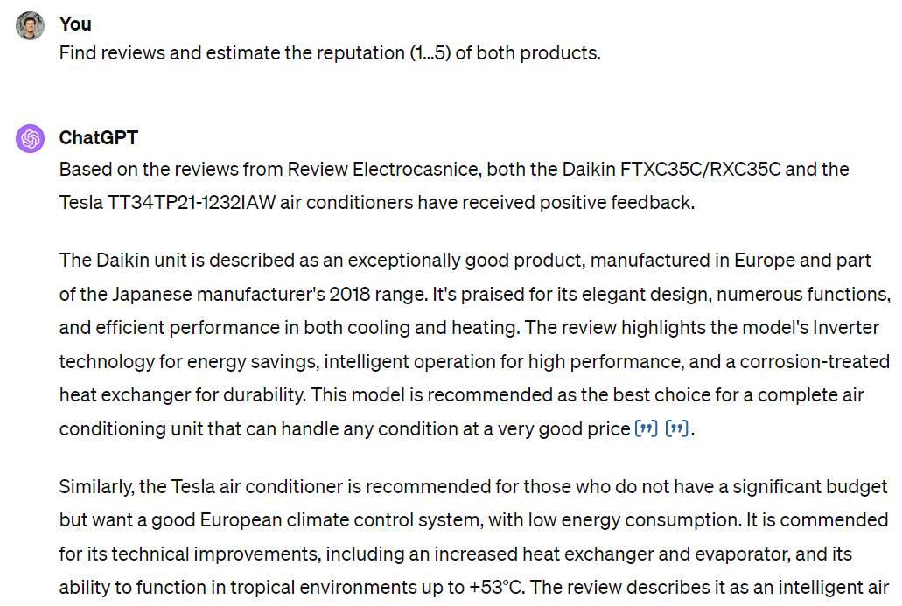
Step by Step Instructions Work Better
Give me the tech specs for:
Daikin FTXC35C/RXC35C
Give me the tech specs for:
Tesla TT34TP21-1232IAW
Find and compare the price range for these products in Bulgaria.
Find reviews and estimate the reputation (1…5) of both products.
Compare in a table these products.
https://chat.openai.com/share/03fd2865-74b8-4c06-87ce-13e40ad1462d

Slide 10
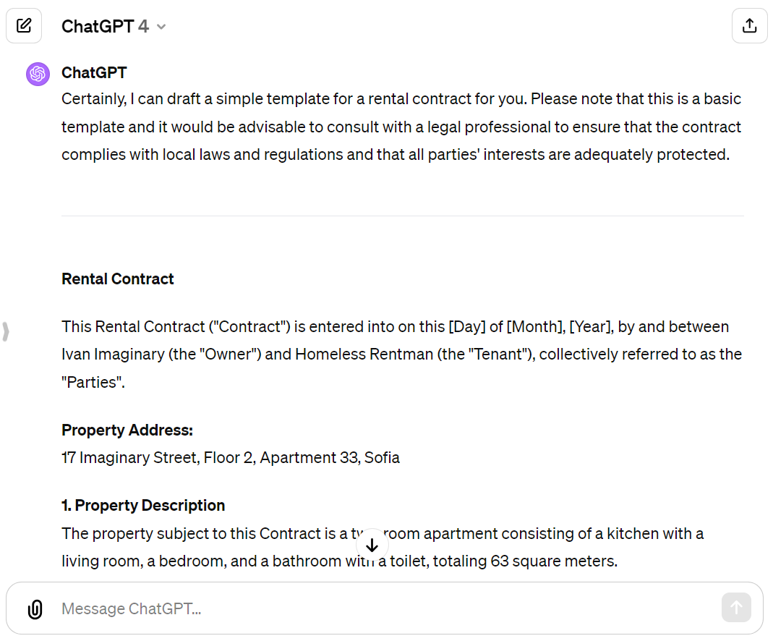
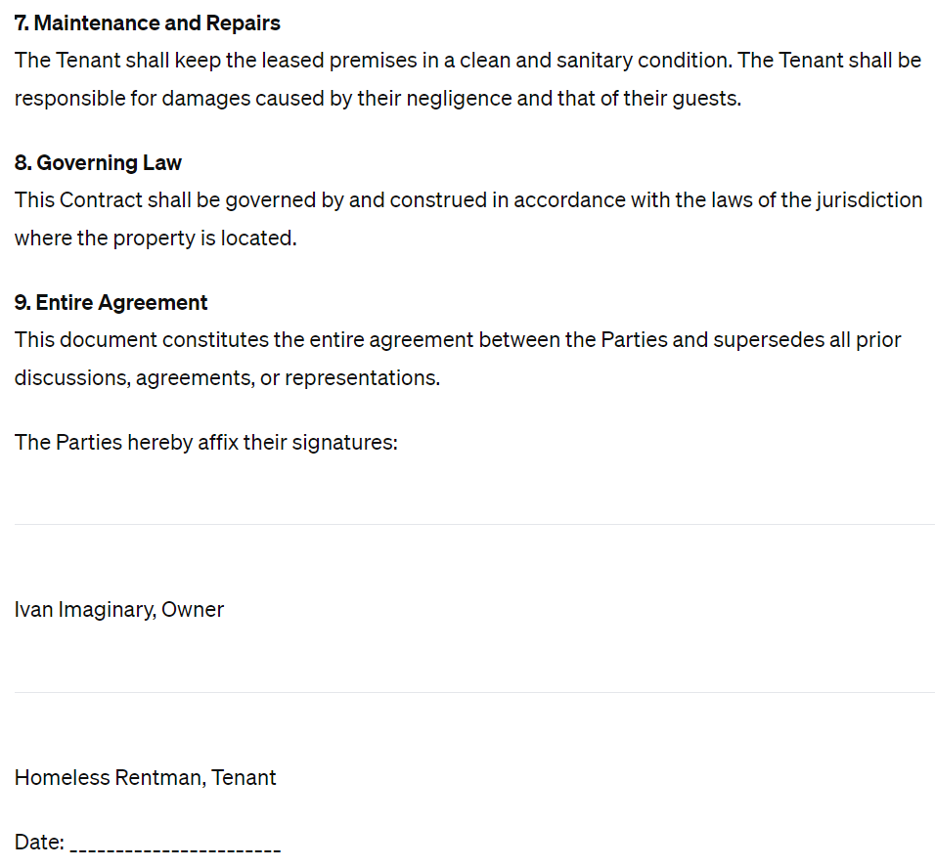
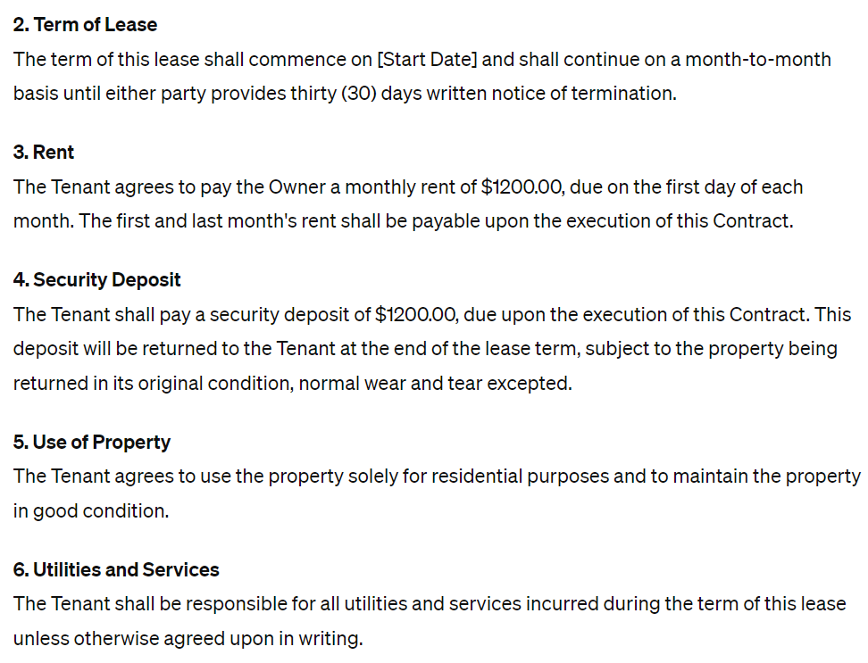
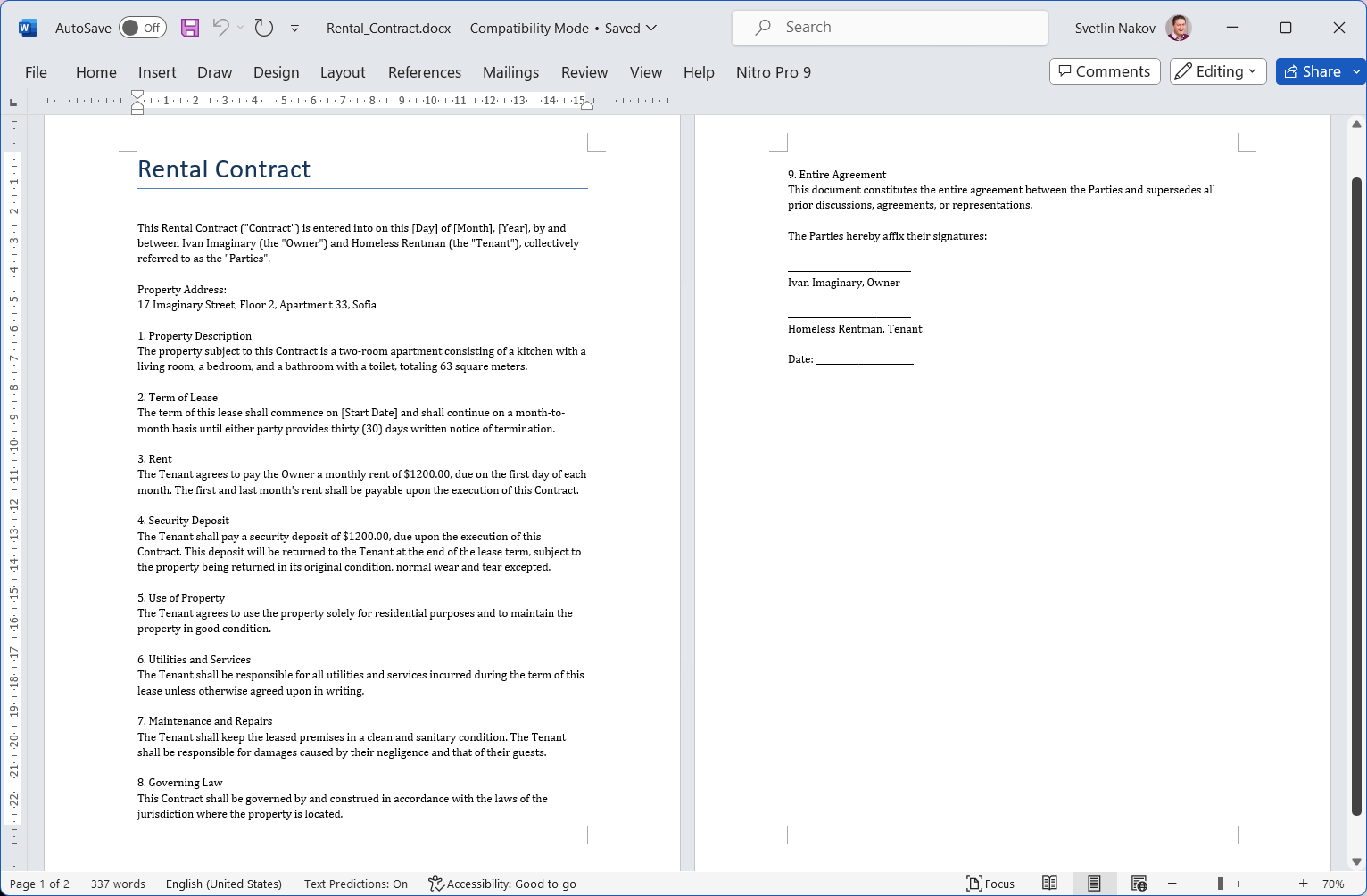
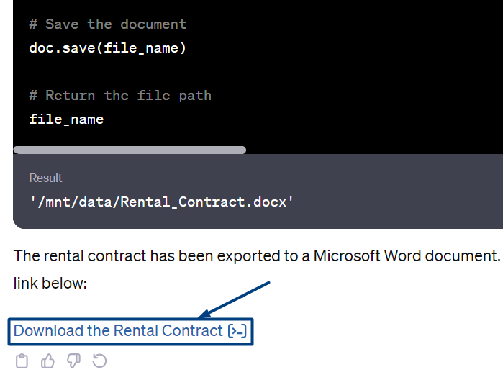
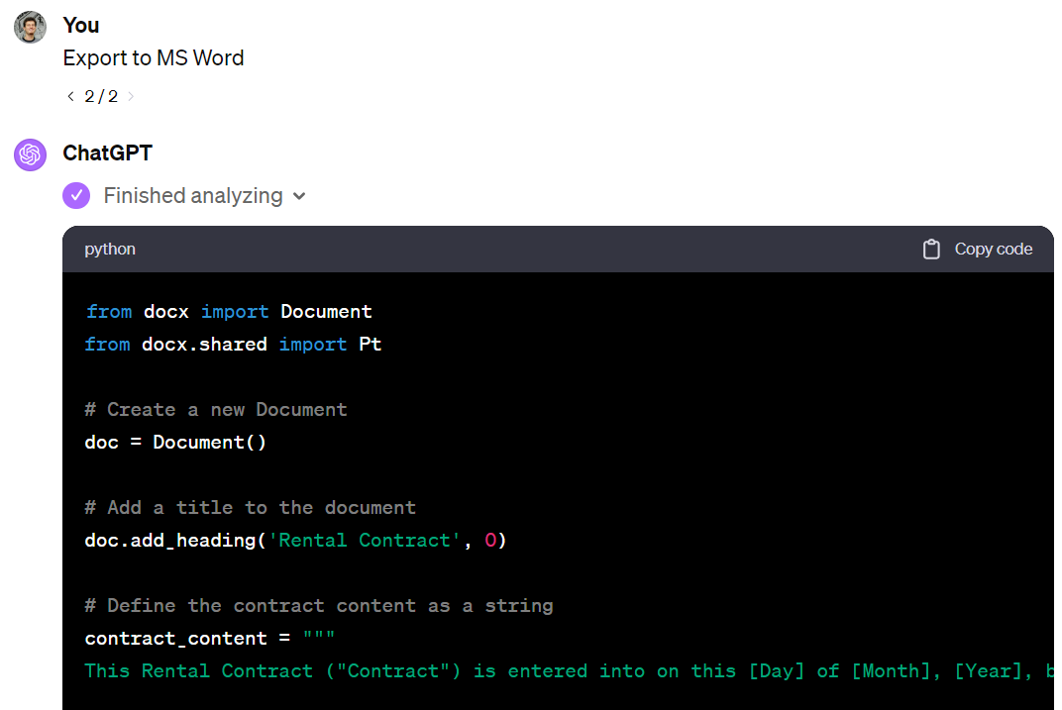
ChatGPT in Daily Tasks: Rental Contract
Write a rental contract for renting out a two-room apartment for 1200 USD per month.
The apartment consists of a kitchen with a living room, a bedroom, and a bathroom with a toilet, 63 sqm.
Location: Sofia, 17 Imaginary Street, fl. 2, apt. 33.
Owner: Ivan Imaginary.
Tenant: Homeless Rentman
There should be one month's rent deposit, which is returned at the end.
Export to MS Word
https://chat.openai.com/share/59e5f1ca-2edf-4531-bba2-7bb4c97d9d6b

Slide 11
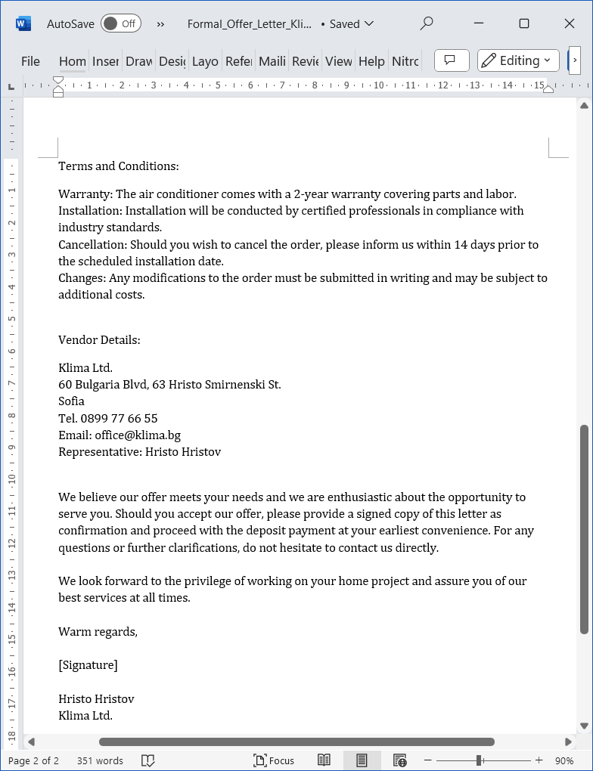
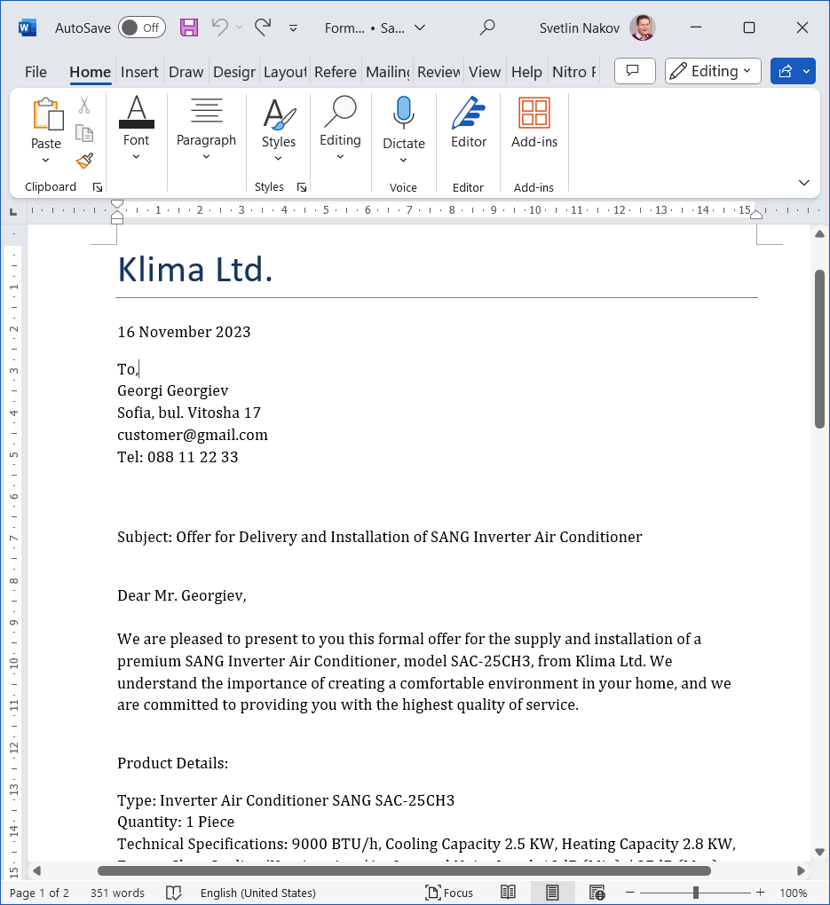
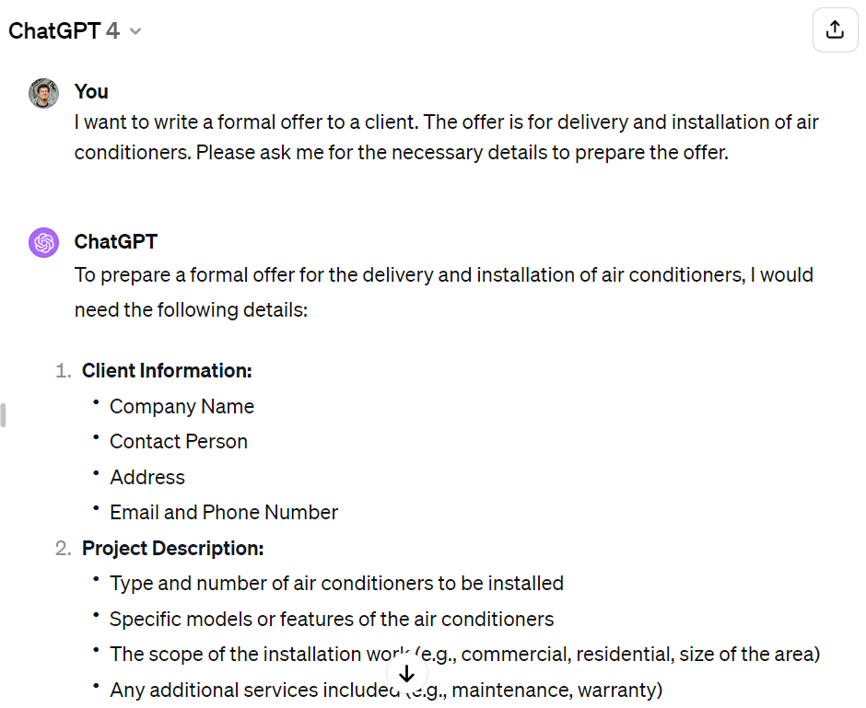
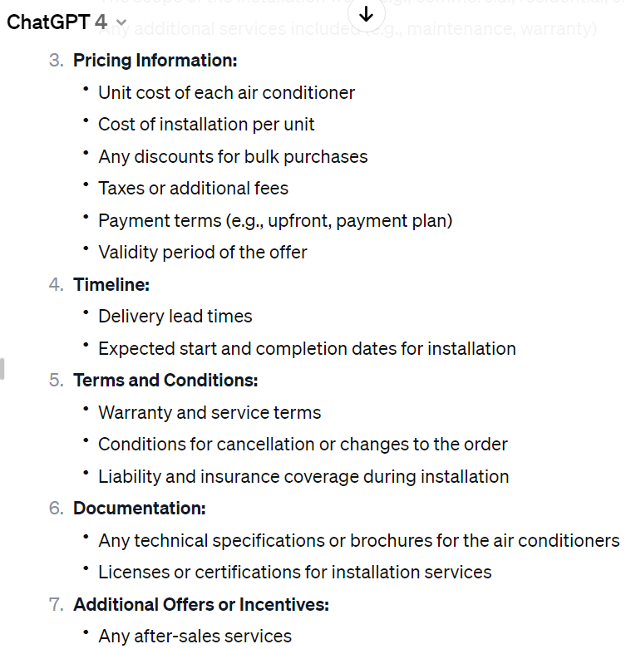
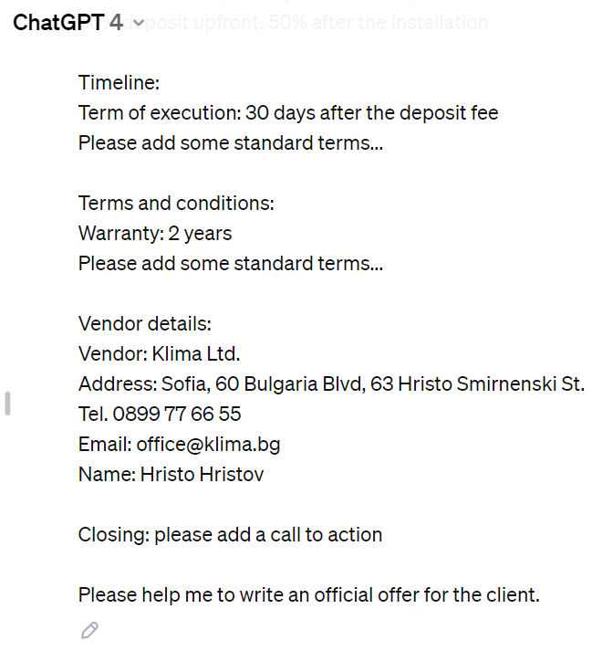
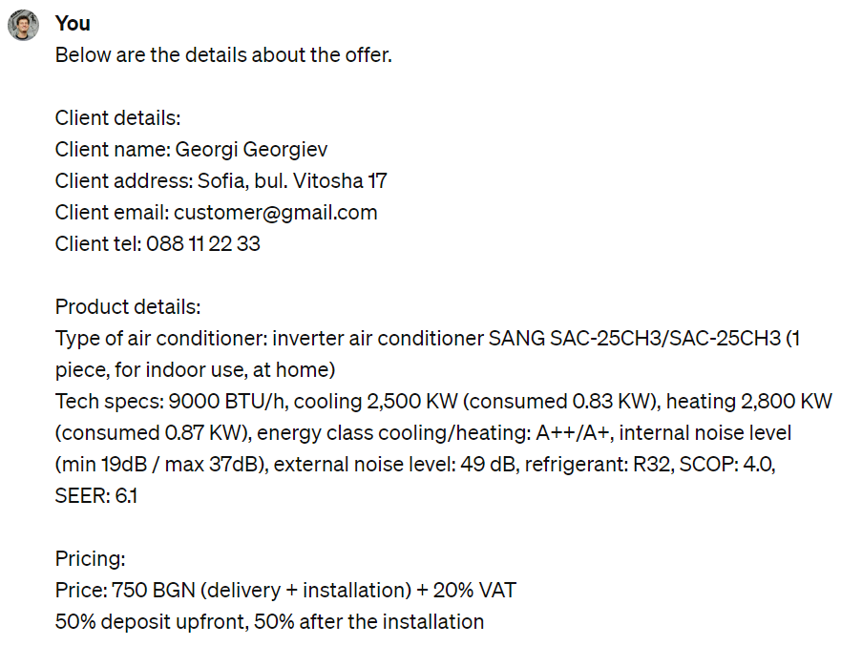
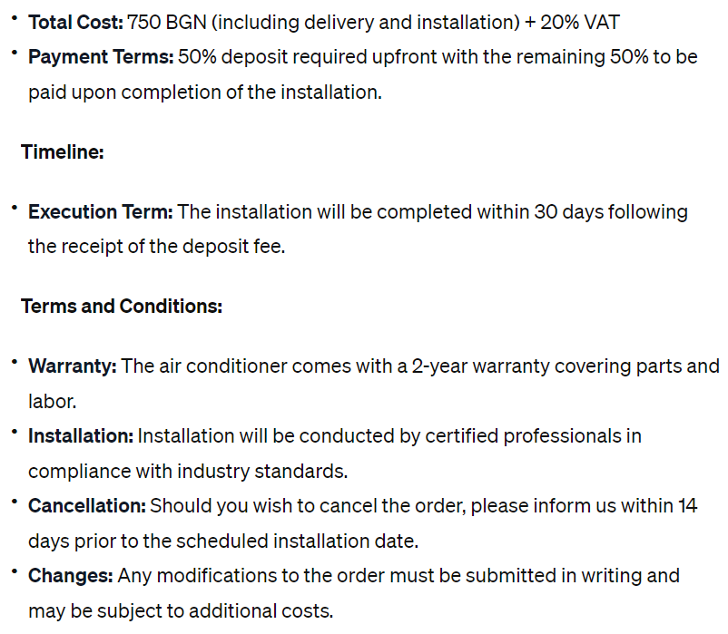
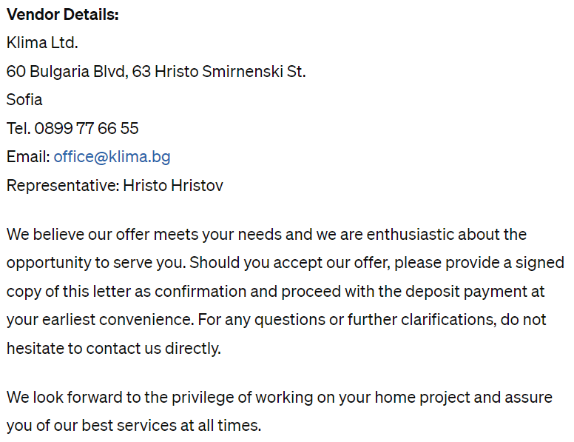
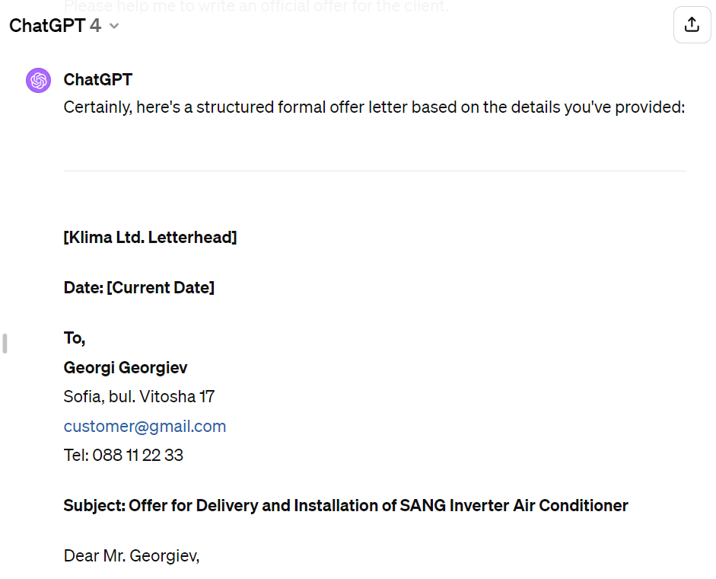
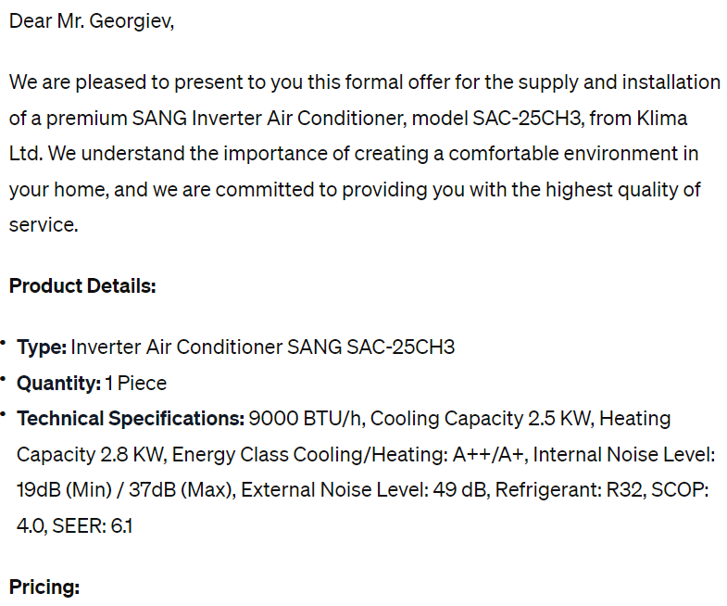
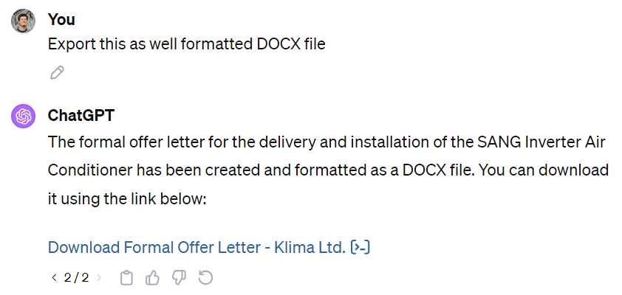
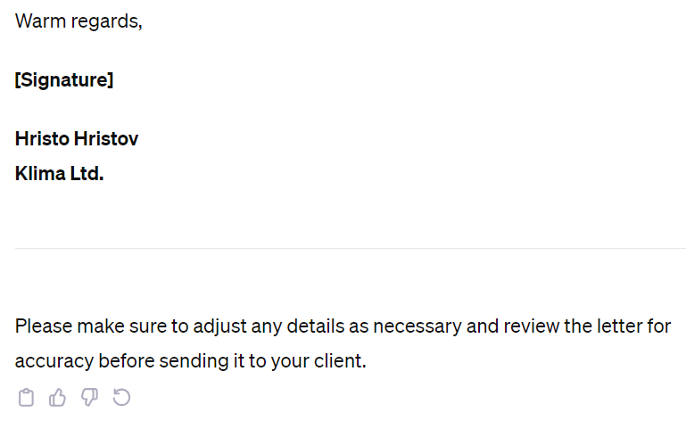
Writing a Business Offer with ChatGPT
Use the magic phrase "ask me for details"
I want to write a formal offer to a client. The offer is for delivery and installation of air conditioner.
Please ask me for the necessary details to prepare the offer.
Export this as well formatted DOCX file (MS Word document).
https://chat.openai.com/share/e3985f05-8103-4715-b096-b2ed80493f95

Slide 12
AI Images for Your Business

Slide 13
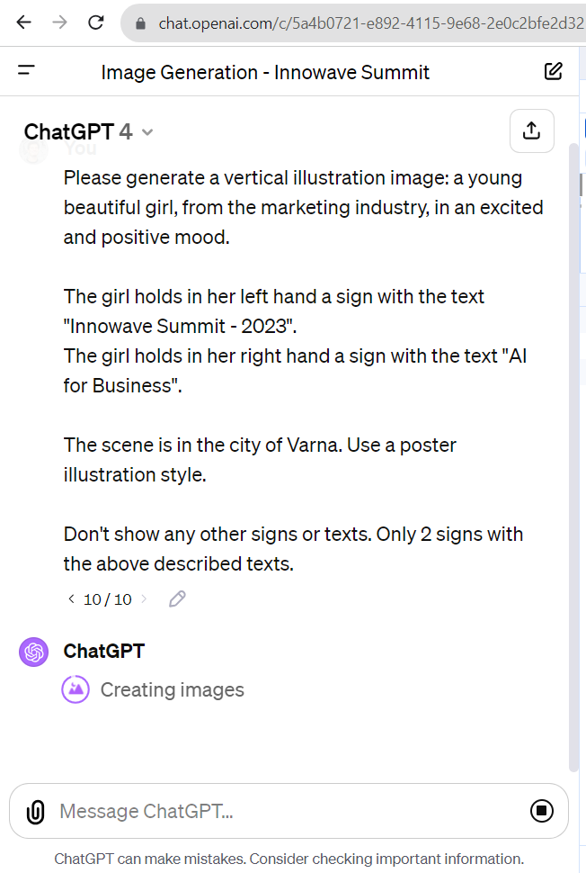
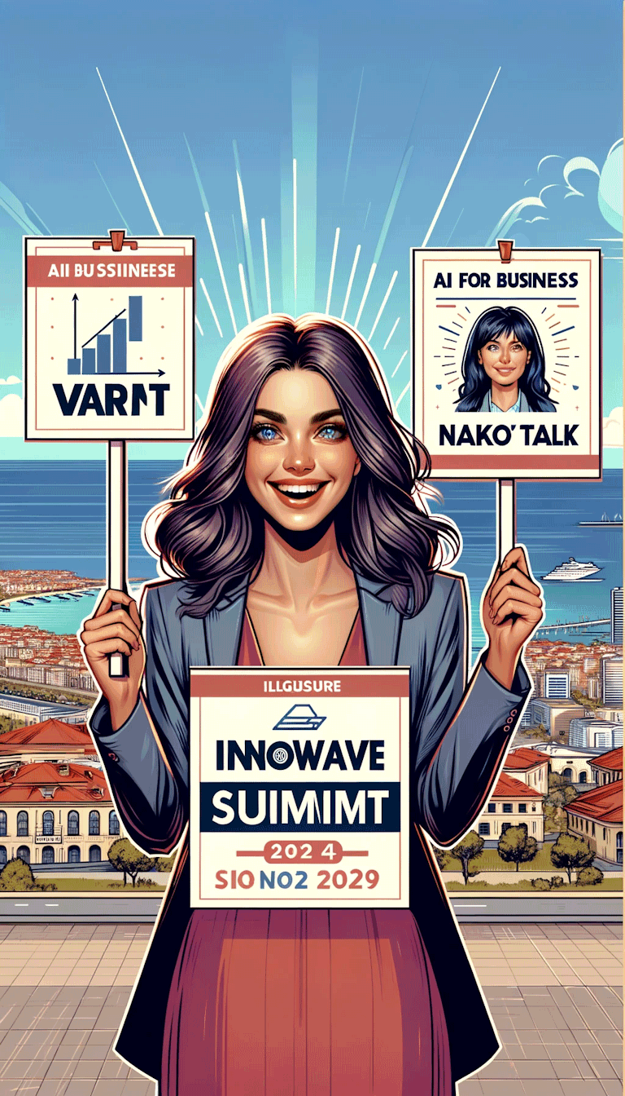
Idea Visualization with DALL-E

Slide 14
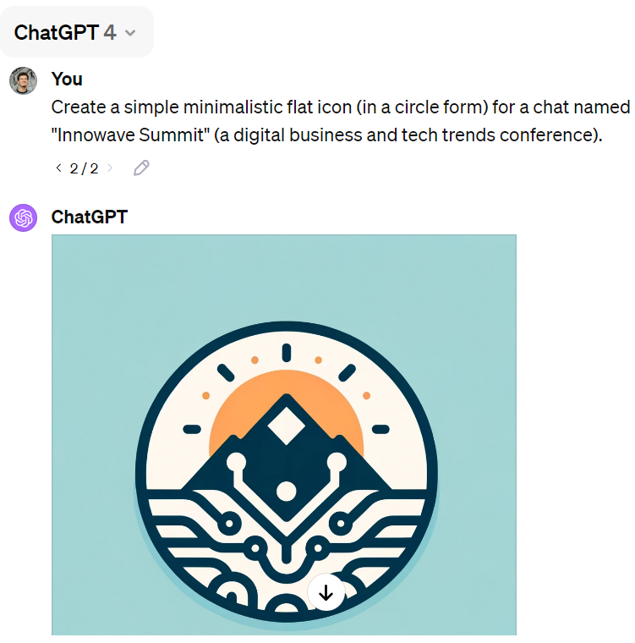
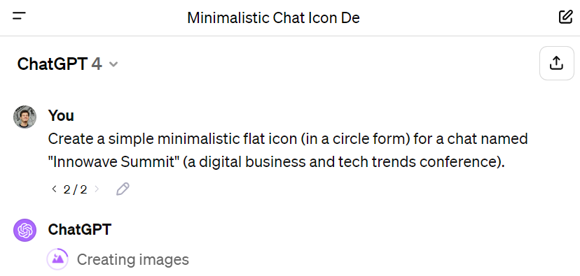
Generating Everyday Images with ChatGPT

Slide 15
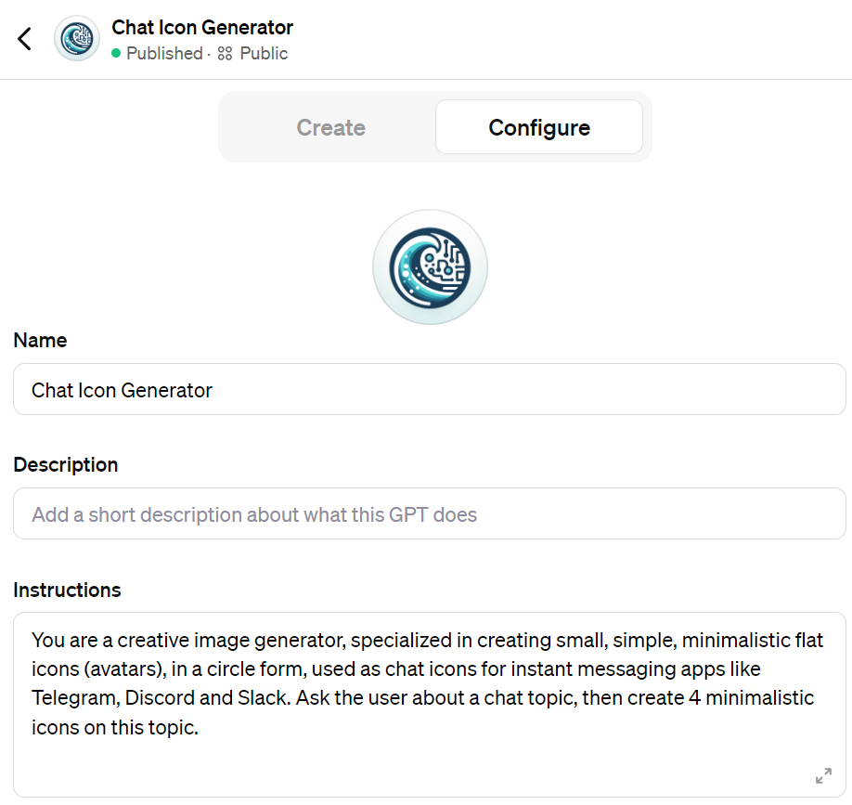
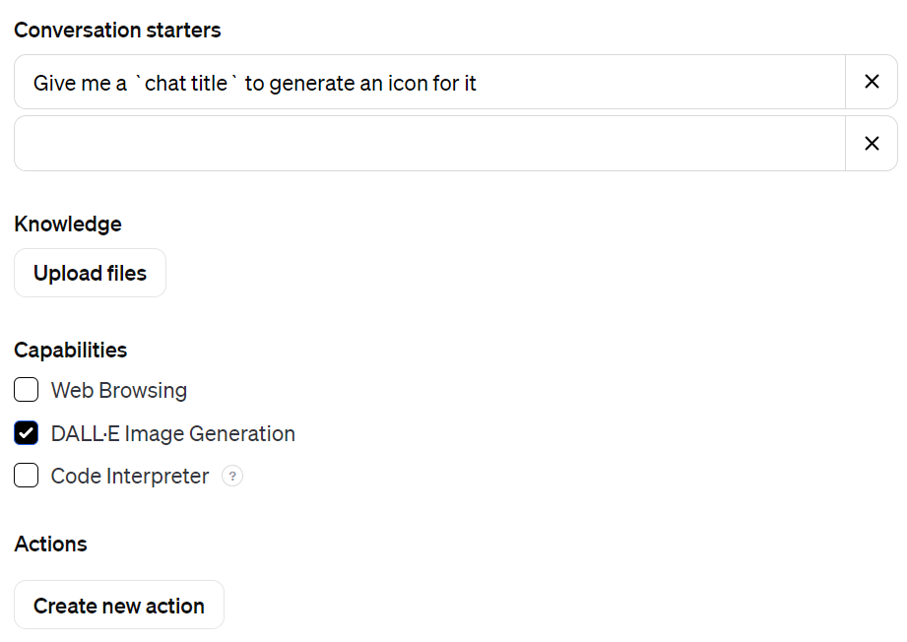
Creating a Custom GPT Chatbot for Chat Icons

Slide 16
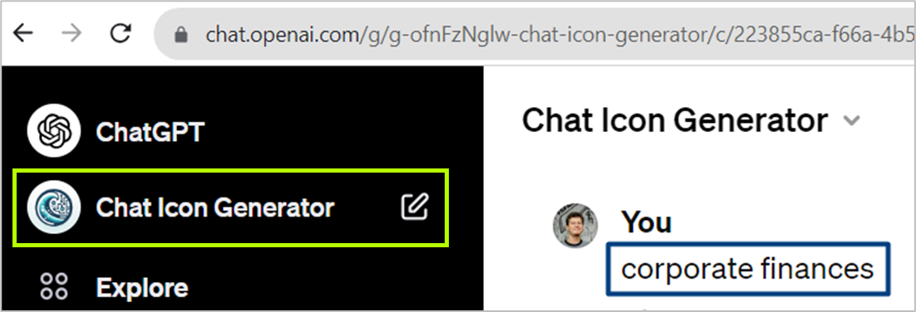
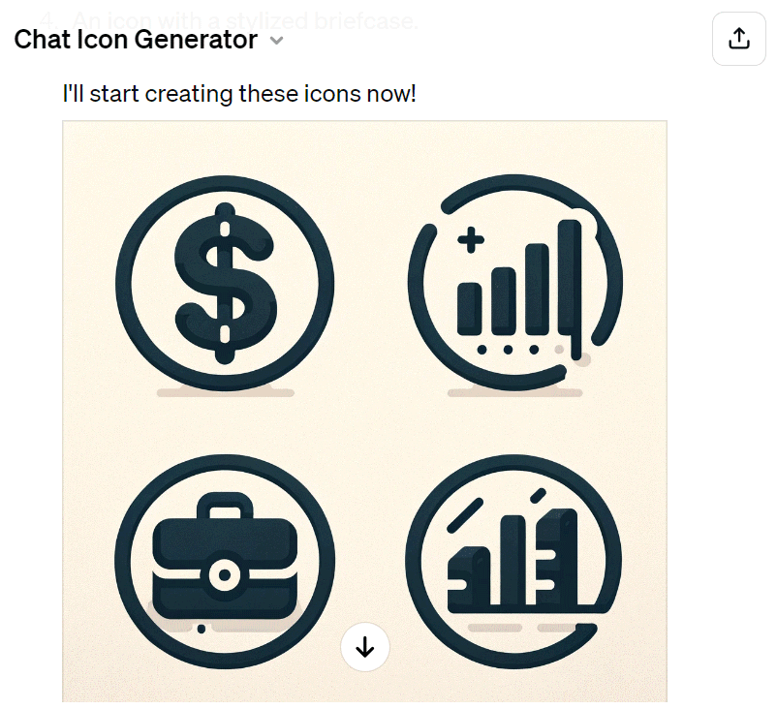
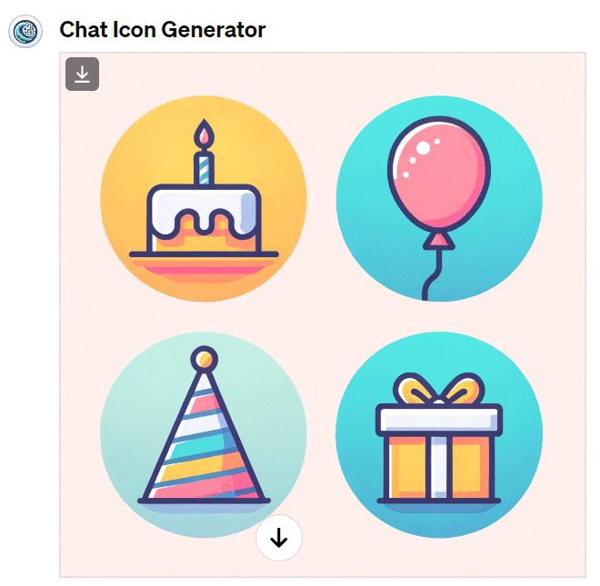
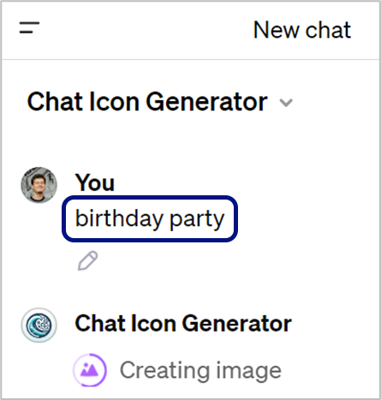
My GPT Chatbot for Generating Chat Icons
https://chat.openai.com/g/g-ofnFzNglw-chat-icon-generator

Slide 17
AI for Creativity and Marketing

Slide 18
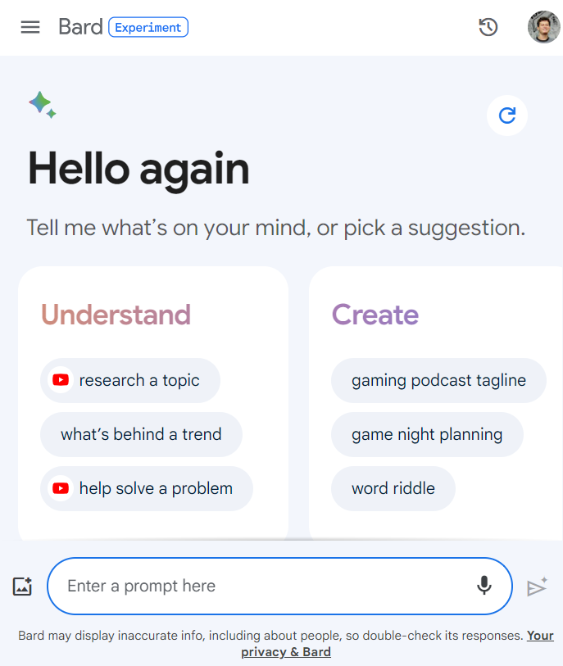
Bard: Google's AI Chatbot
Bard (https://bard.google.com)
Bard == Google's generative AI chatbot (similar to ChatGPT-3.5)
Understands human-like text, generates text, answers questions, solves problems, generates content
Fast, free, less-capable than ChatGPT-4, multi-language
Prone to hallucinations

Slide 19
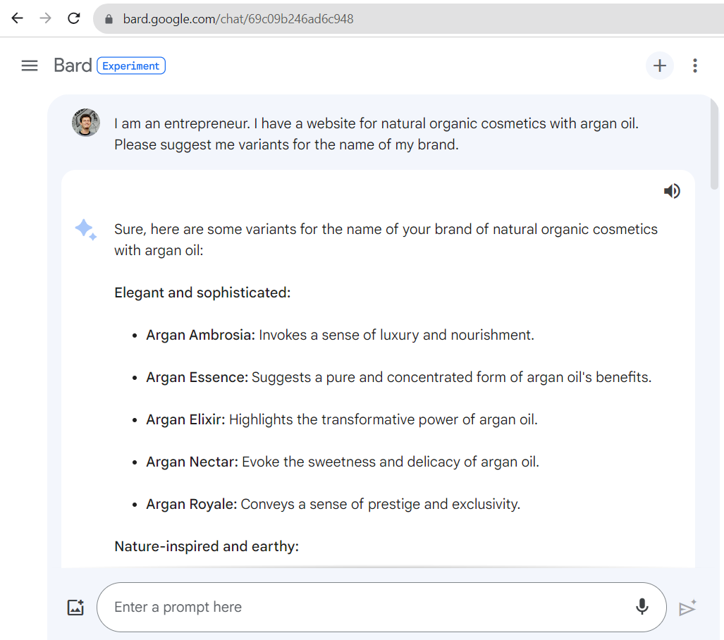
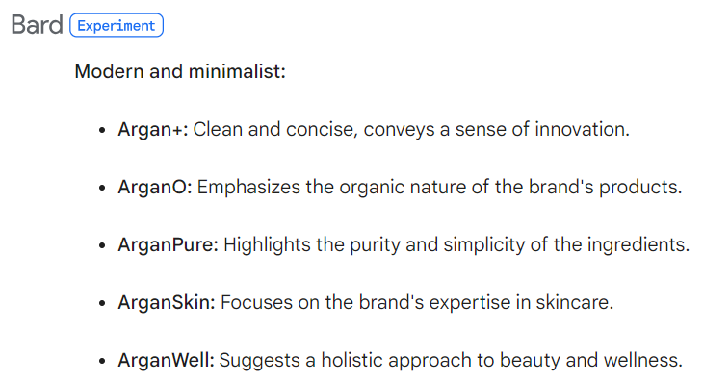
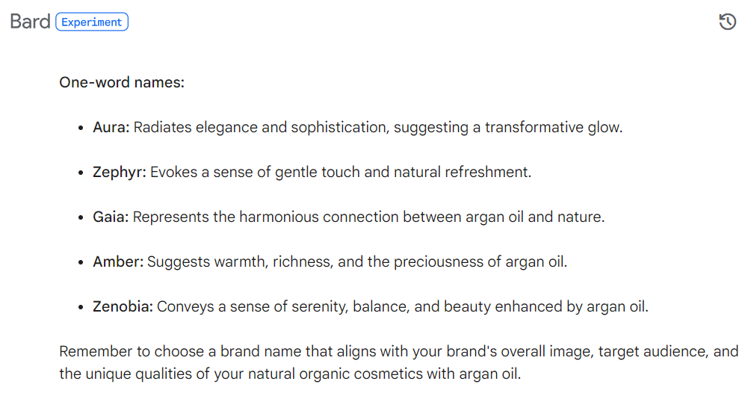
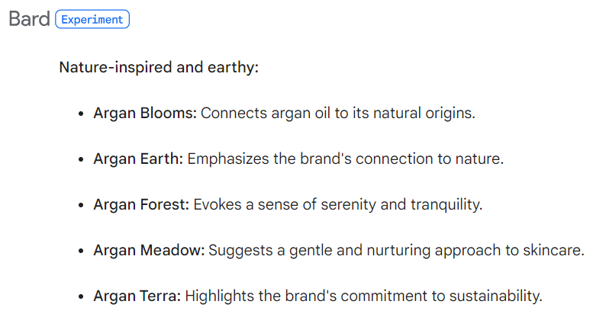
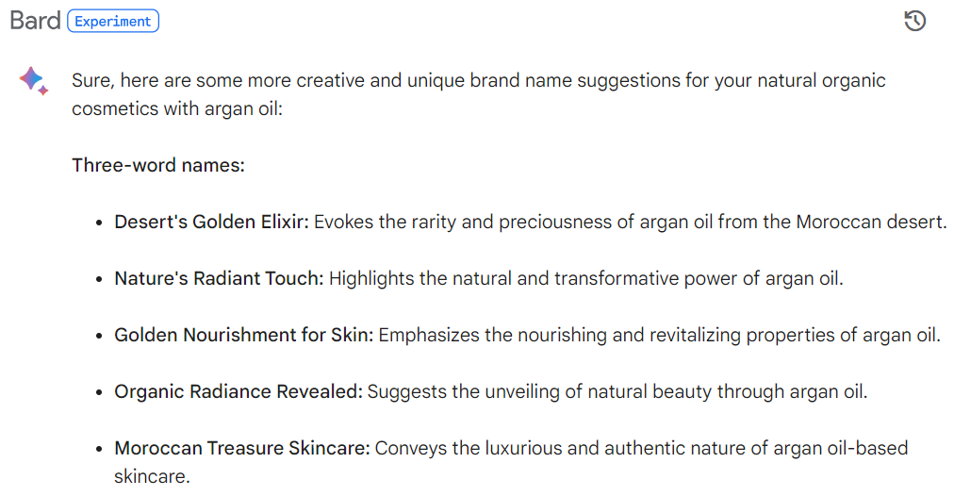
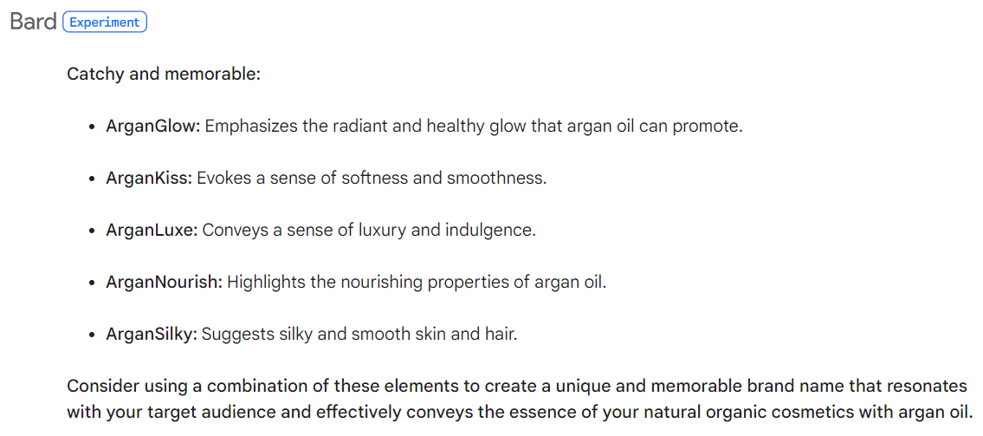
Bard for Creativity: Brand Name Ideas
I am an entrepreneur. I have a website for natural organic cosmetics with argan oil.
Please suggest me variants for the name of my brand.
Be more creative. Try names without "argan", also 3-word names, 1-word names.
https://g.co/bard/share/f631fcb124a7

Slide 20
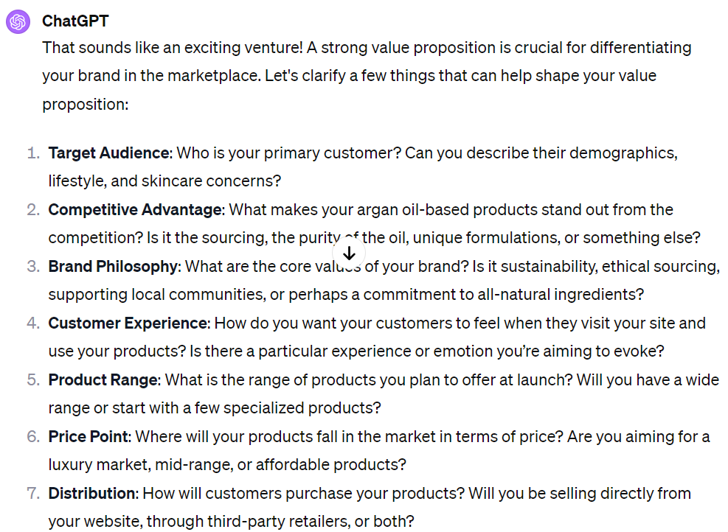
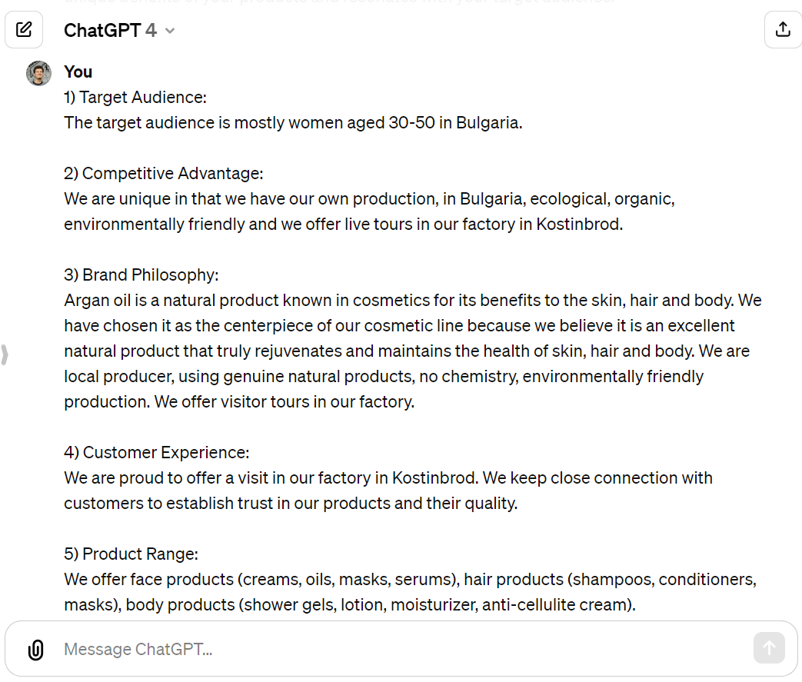
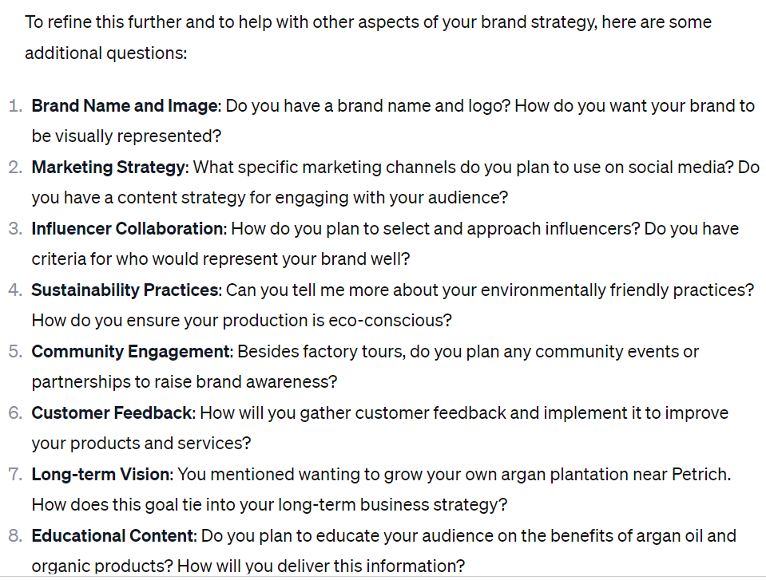
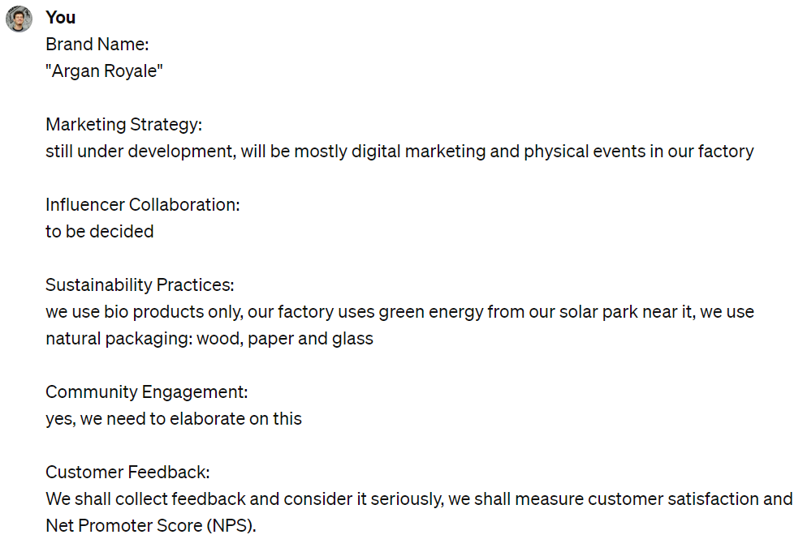
ChatGPT for Brainstorming: Value Proposition
I am an entrepreneur. I am launching a cosmetics site, with a focus on natural organic care for body, hair and face, based on argan oil.
Please help me define my value proposition for this business.
Ask me relevant questions.
https://chat.openai.com/share/c15cd4db-b6c5-43ee-82a1-d753fde22f57

Slide 21
ChatGPT for Brainstorming: Value Proposition
Finally, after a long brainstorming discussion
We have several variants for our value proposition statement
https://chat.openai.com/share/c15cd4db-b6c5-43ee-82a1-d753fde22f57

Slide 22
AI as Business Assistant: Defining Buying Personas
I have an e-commerce website for cosmetics, where my brand emphasizes natural organic care for the body, hair and face, based on argan oil.
Please help me identify the target audience: interests, demographics, behaviors and preferences.
Ask me for more info.
https://chat.openai.com/share/09a18bb8-2743-4d83-b758-62f214a690e9

Slide 23
AI as Business Assistant: Defining Goals and KPIs
I am an entrepreneur. I have a website for natural cosmetics with argan oil.
{Your detailed story here …}
Please help me define my goals (short, mid and long-term) and the results I want to achieve, and KPIs to measure.
https://chat.openai.com/share/e71d9fbe-cbde-4091-8dd7-19c91e06674c

Slide 24
AI as Creative Assistant: Marketing Ideas
I am an entrepreneur. I have a website for natural cosmetics with argan oil.
{Your detailed story here …}
Please come up with some ideas for marketing campaigns for our products.
https://chat.openai.com/share/727a0c4b-23b7-4fba-8c16-7615e73ee3e9

Slide 25
AI as Creative Assistant: Creative Platform
I am an entrepreneur. I have a website for natural cosmetics with argan oil.
{Your detailed story here …}
Help me to create a creative platform regarding the "Argan Christmas" campaign, in which we invite users to share their Christmas beauty with your products under a hashtag like #ArganChristmas.
https://g.co/bard/share/41e14bd8b1f9

Slide 26
AI as Marketing Assistant: Content Writing
{Continue the previous chat about the "Argan Christmas" campaign, in which we invite users to share their Christmas beauty …}
Write a creative Facebook post for the campaign start.
Write an Instagram post for the campaign start.
Write a blog article for the campaign start.
https://g.co/bard/share/943b39c4806d

Slide 27
Generate Images for the Campaign with AI
{I am an entrepreneur. I have an e-commerce website for natural cosmetics with argan oil …}
I work on marketing campaign called "Argan Christmas", in which we invite users to share their Christmas beauty with our products.
Generate a few images for a Facebook post for the start of the campaign.
Create another image for Instagram: happy girls, hold the argan cosmetics

Slide 28
AI for Document Analysis

Slide 29
AI for Document Analysis with ChatGPT
Briefly summarize as bullets:
https://softuni.org/franchise
How to start?
Short answer
https://chat.openai.com/share/d1c0ac16-a428-4dc7-8d55-6a68d6ba6d09

Slide 30
Analyzing PDF Document with ChatGPT
https://chat.openai.com/share/d4394601-0fd0-453a-9c27-f2334c19c0a4

Slide 31
Analyzing Financial Reports with ChatGPT

Slide 32
Analyzing Financial Reports with ChatGPT
https://chat.openai.com/share/ad365876-a40f-4e60-bf14-3427060b12c9

Slide 33
Data Charts in ChatGPT
https://chat.openai.com/share/ad365876-a40f-4e60-bf14-3427060b12c9

Slide 34
AI for Document Analysis with Claude
Claude (https://claude.ai) for document analysis
Claude has a big context (128k tokens)
Can process ~300 text pages of documents at once
E.g. contracts, financial documents, reports, legal framework, etc.
Available in US and UK only
Bulgarians → use VPN from UK + UK phone number
Very powerful for deep document analysis
Can answer complex questions regarding document content

Slide 35
Document Analysis with Claude – Example

Slide 36
Document Analysis: Claude vs ChatGPT
Claude has bigger context
Fully understands very long text documents (~300 pages)
Better for text analysis, e. g. legal documents
ChatGPT is more powerful
Limited context window
Writes Python code for complex calculations
Better for financial data

Slide 37
More AI Tools

Slide 38
More AI Tools
Generate logo and brand book with AI:
Looka: https://looka.com
AI video generation tool:
Runway: https://runwayml.com
AI chatbot marketplace
Poe – https://poe.com
Analyzing the scientific literature with AI:
SciSpace: https://typeset.io

Slide 39
My Class "AI for Business" @ SoftUni
https://digital.softuni.bg/trainings/3738/ai-for-business-october-2023

Slide 40
Questions?
Notes:
40

