Slide 1


Software Requirements from the Developer's Perspective
Classical vs. Agile Requirements Development
Svetlin Nakov
Senior Technical Trainer
www.nakov.com
Telerik Software Academy
academy.telerik.com

Slide 2

Agenda
Software Engineering Overview
Development Methodologies Overview
Software Requirements Overview
  Specifications
  Prototyping
  User Stories

Slide 3

Software Engineering
Requirements, Design, Construction, Testing, …

Slide 4


What is Software Engineering?
Software engineering is the application of a systematic, disciplined, quantifiable approach to the development, operation, and maintenance of software
Definition by IEEE

Slide 5

Software Engineering
Software engineering is:
  An engineering discipline that provides knowledge, tools, and methods for:
    Defining software requirements
    Performing software design
    Software construction
    Software testing
    Software deployment and maintenance tasks
    Software project management

Slide 6
Software Development Activities
Software development always includes the following activities (to some extent):
  Requirements analysis
  Design
  Construction
  Testing (sometimes)
These activities do not follow strictly one after another (depends on the methodology)!
  Often overlap and interact
Software Project Management

Slide 7

Development Methodologies
Waterfall, Scrum, Lean Development, Kanban, Extreme Programming

Slide 8
What is a Software Development Methodology?
A development methodology is a set of practices and procedures for organizing the software development process
  A set of rules that developers have to follow
  A set of conventions the organization decides to follow
  A systematical, engineering approach for organizing and managing software projects

Slide 9
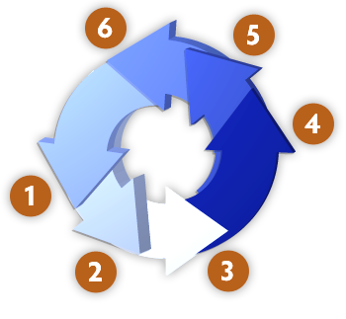
Development Methodologies
Back in history
  The "Waterfall" Process
    Old-fashioned, not used today
  Rational Unified Process (RUP)
  Microsoft Solutions Framework (MSF)
Modern development methodologies
  Agile development processes
  Scrum, Kanban, Lean Development, Extreme Programming (XP), etc.

Slide 10



The Waterfall Development Process

Slide 11
The Waterfall Process
The waterfall development process:
Software
Requirements
Software
Design
Implementation
(Coding)
Verification
(Testing)
Operation
(Maintenance)
Notes:
It’s only in testing that your design is tested against reality. At this point you always learn something about your design (usually that it is wrong!), and that tells you something about your requirements (ditto!)

Slide 12

Agile Development

Slide 13

The Agile Manifesto
  “Our highest priority is to satisfy the
  customer through early and continuous
  delivery of valuable software“
Manifesto for Agile

Slide 14

The Agile Spirit
Incremental
  Working software over comprehensive documentation
Cooperation
  Customer collaboration over contract negotiation
Straightforward
  Individuals and interactions over processes and tools
Adaptive
  Responding to change over following a plan

Slide 15
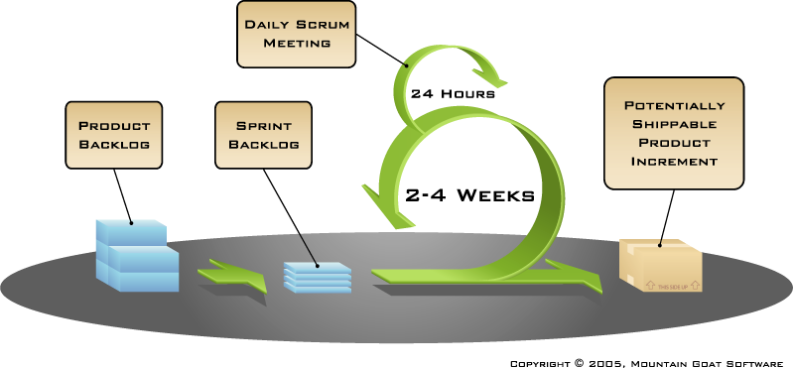
The Scrum Process Framework

Slide 16

Software Requirements
Functional, Non-functional Requirements, SRS

Slide 17

Software Requirements
Software requirements define the functionality of the system
  Answer the question "what?", not "how?"
  Define constraints on the system
Two kinds of requirements
  Functional requirements
  Non-functional requirements

Slide 18
Requirements Analysis
Requirements analysis starts from a vision about the system
  Customers don't know what they need!
  Requirements come roughly and are specified and extended iteratively
The outcome might be the Software Requirements Specification (SRS)
Prototyping is often used, especially for the user interface (UI)

Slide 19

Software Requirements Specification (SRS)
The Software Requirements Specification (SRS) is a formal requirements document
It describes in details:
  Functional requirements
    Business processes
    Actors and use-cases
  Non-functional requirements
    E.g. performance, scalability, constraints, etc.

Slide 20
Software Requirements
It is always hard to describe and document the requirements in comprehensive way
  Good requirements save time and money
Requirements always change during the project!
  Good software requirements specification reduces the changes
  Prototypes significantly reduce changes
  Agile methodologies are adaptive to changes

Slide 21

Software Requirements Specifications (SRS)
Live Demo

Slide 22
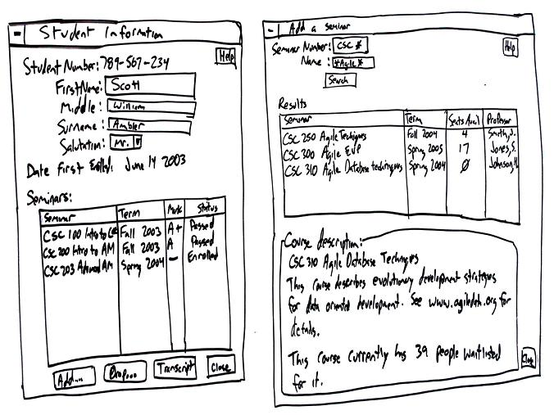
Software Prototyping
Using UI Prototypes instead of Specification

Slide 23
What is Software Prototype?
Software prototype is a prototype of the software functionality
  Sketch of the UI matching the requirements

Slide 24
UI Prototyping Tools
Paper and pen
  The most universal prototyping tool
Balsamiq Studio – balsamiq.com
Microsoft Expression SketchFlow
Pencil Project – pencil.evolus.vn

Slide 25
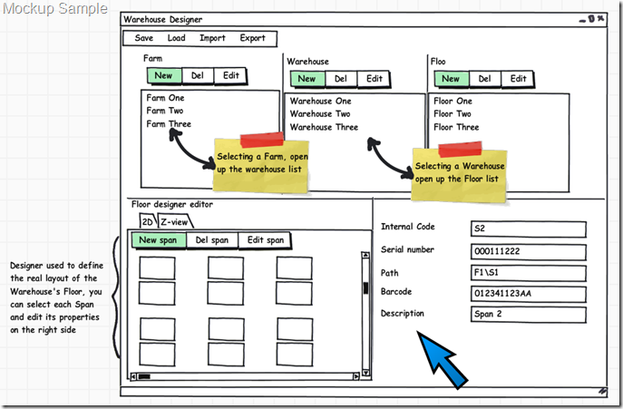
UI Prototypes
Live Demo

Slide 26
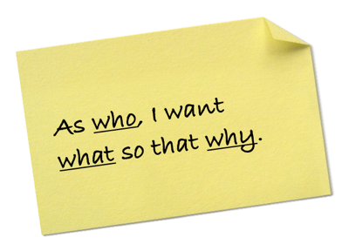
User Stories
The Agile Principles in Requirements Process

Slide 27
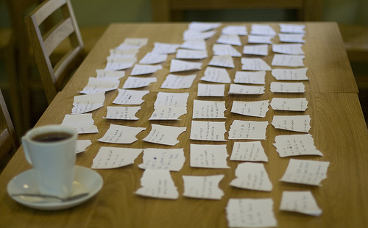
What is User Story?
User story
  User needs to accomplish something
  Written informal (in words / images)
  Looks like use-case but is different
User stories have
  Actor (who?)
  Goal (what?, why?)
  Other info
    Owner, estimate, …

Slide 28
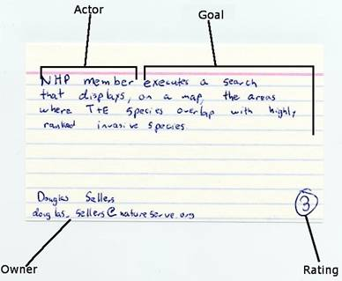
User Story – Example

Slide 29
The 3C of the User Stories
Card
  A brief description of the feature
  In "Actor –goal" format
Conversation
  More details, emails, chats, images, etc.
Confirmation
  Test scenarios for success and failure

Slide 30
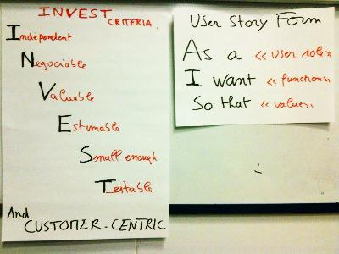
The INVEST Model
A well written User Story should follow the INVEST model
  Independent
  Negotiable
  Valuable
  Estimable
  Small
  Testable

Slide 31
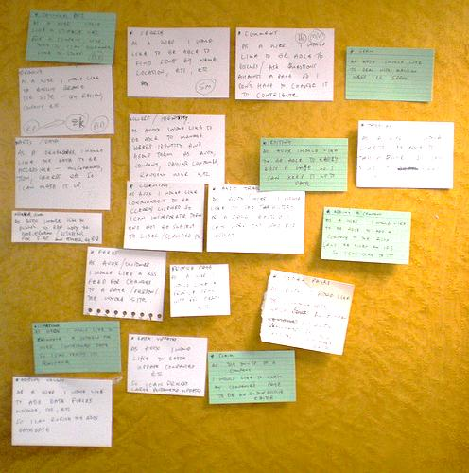
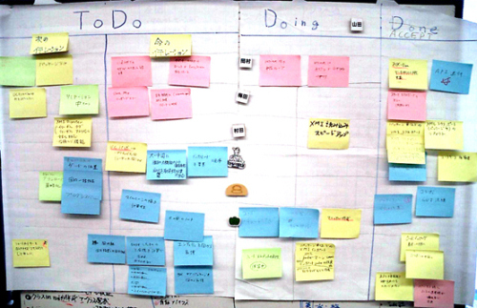
User Stories
Live Demo

Slide 32
Software Requirements from the Developer's Perspective
?
?
?
?
?
Questions?
?
?
?
?
?
http://academy.telerik.com

