Slide 1
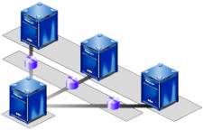



Software Configuration Management
http://schoolacademy.telerik.com
Source Control Repositories for Enabling Team Working
Svetlin Nakov
Telerik Corporation
www.telerik.com

Slide 2
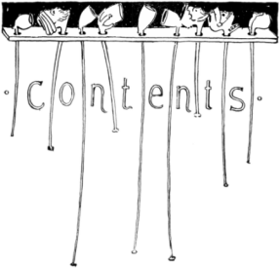
Table of Contents
Systems for Software Configuration Management (SCM)
Version Control
  Basic notions and principles
Versioning Models
  Lock-Modify-Unlock
  Copy-Modify-Merge
Project Hosting Sites

Slide 3
Software Configuration Management (SCM)
Version Control ≈ Software Configuration Management
  A discipline of the software engineering
  Consists of techniques, practices and tools for their application
  Mechanisms for management, control and accounting of the changes
  Defines the process of change
  Keeps track of what is happening in the project
  Solves conflicts in the changes

Slide 4

SCM and the Software Development Lifecycle
Release
The Final
Product
Testing
Analysis
Text
Scripts
and Data
Requirements
SCM
Build
Scripts,
Final
Product
Models
Release
Design
Source Code
Implementation

Slide 5

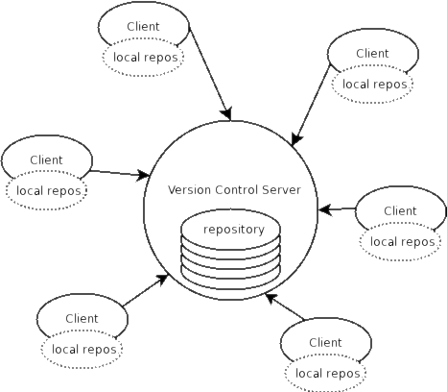

Version Control
Managing Different Version of the
Same File (Document)

Slide 6

Version Control Systems
Functionality
  File versions control
  Merge and differences search
  Branching
  File locking
  Console and GUI clients
Well known products
  CVS, Subversion (SVN) – free, open source
  Git, Mercurial – distributed, free, open source
  Perforce, Microsoft TFS – commercial

Slide 7
Version Control
Constantly used in software engineering
  During the software development
  While working with documents
Changes are identified with an increment of the serial number
  “version number”, for example 1.0, 2.0, 2.17
Version numbers are historically linked with the person who created them

Slide 8
Change Log
Systems for version control keep a complete change log (history)
  The date and hour of every change is stored
  The user who made the change is stored
Old versions can be retrieved, examined and compared
It is possible to return to an old version (revert)

Slide 9
Vocabulary
Repository
  A server that stores the files (documents)
  Keeps a change log
Revision, Version
  Individual version (state) of a document that is a result of multiple changes
Check-out
  Retrieves a working copy of the files from the repository into a local directory
  It is possible to lock the files

Slide 10
Vocabulary (2)
Change
  A modification to a local file (document) that is under version control
Change List
  A set of changes to multiple files that are going to be committed at the same time
Commit, Check-in
  Applying the changes made on the work copy to the files in the repository
  Automatically creates a new version
  Conflicts may occur!

Slide 11
Vocabulary (3)
Conflict
  The simultaneous change to a file by multiple users
  Automatic and manual solving
Update, Get Latest Version
  Checking-out the changed files from the repository to a local directory
Undo Check-out
  Cancels the changes to a group of files
  Restores their state from the repository

Slide 12
Vocabulary (4)
Merge
  Combining the changes to a file simultaneously made by different users
  Can be automated in most cases
Label, Tag
  Labels mark with a name a group of files in a given version
  For example a release
Branching
  Division of the repositories in a number of separate work flows

Slide 13

Version Control: Typical Scenario
Users
Repository
Main
development
line
User A
Version A Branch
Version A.1 Branch
Check Out
Check In
C
A
User B
B
Version B Branch
Check Out
D
Merge
E
Check In

Slide 14



Versioning Models
Lock-Modify-Unlock and
Copy-Modify-Merge

Slide 15
Versioning Models
Lock-Modify-Unlock:
  Only one user works on a given file at a time → no conflicts
  Example: Visual SourceSafe, TFS
Copy-Modify-Merge:
  Users make parallel changes to their own working copies
  The parallel changes are merged and the final version emerges
  Examples: CVS, Subversion

Slide 16
Locking Problems
Administrative problems:
  Someone locks a given file and forgets about it
  Time is lost while waiting for someone to release a file
Unneeded locking of the whole time
  Different changes are not necessary in conflict
  Example: Andy works on the begging of the file and Bobby works on the end

Slide 17
Merging Problems
If a given file is concurrently modified it is necessary to merge the changes
  Merging is hard!
    It is not always possible to do it automatically
Responsibility and coordination between the developers is needed
  Commit as fast as you can
  Do not commit code that does not compile or blocks the work of the others
  Add comments on commit

Slide 18
File Comparison / Merge
During manual merge use file comparison
There are visual comparison / merge tools:
  TortoiseMerge
  WinDiff
  AraxisMerge
  BeyondCompare
  CompareIt
  …

Slide 19
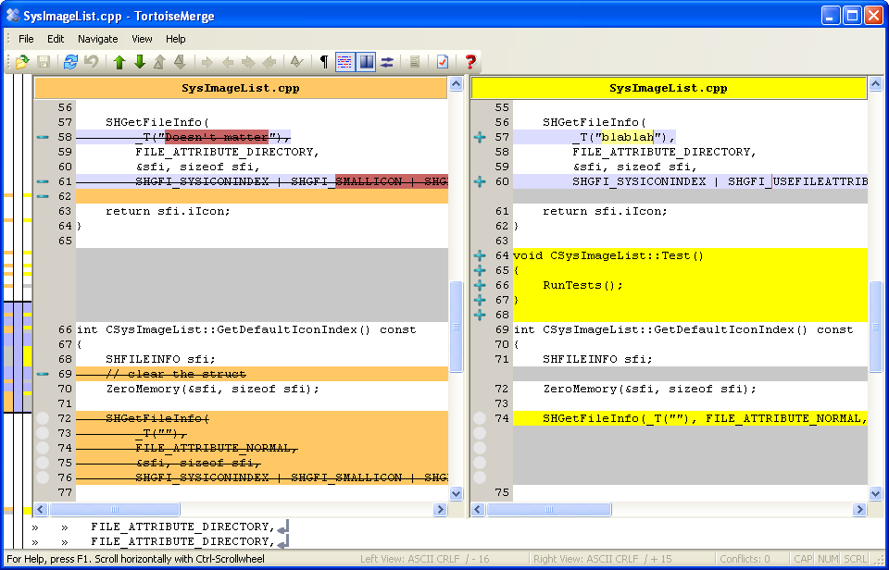
File Comparison – Example

Slide 20


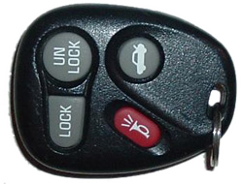
The
"Lock-Modify-Unlock" Model

Slide 21



The Lock-Modify-Unlock Model (1)
Andy and Bobby check-out file A.
The check-out is done without locking. They just get a local copy.
Repository
A
Update
Update
A
A
Bobby
Andy

Slide 22

The Lock-Modify-Unlock Model (2)
Andy locks file A and begins modifying it.
Repository
A
Lock
A
Аndy
(Local Edit)
Bobby
Andy

Slide 23

The Lock-Modify-Unlock Model (3)
Bobby tries to lock the file too, but she can’t.
Bobby waits for Andy to finish and unlock the file.
Repository
A
Wait
A
Andy
Bobby
Andy

Slide 24
The Lock-Modify-Unlock Model (4)
Andy commits the changes and unlocks the file.
Repository
Andy
Commit
Andy
Andy
Bobby
Andy

Slide 25
The Lock-Modify-Unlock Model (5)
Now Bobby can take the modified file and lock it.
Bobby edits her local copy of the file.
Repository
Andy
Lock
Andy
Andy
(Local Edit)
Bobby
Andy

Slide 26
The Lock-Modify-Unlock Model (6)
Bobby finishes, commits her changes and unlocks the file.
Repository
Andy
Bobby
Commit
Andy
Bobby
Andy
Bobby
Andy

Slide 27
The Lock-Modify-Unlock Model (7)
Andy updates the changes from the repository.
Repository
Andy
Bobby
Update
Andy
Bobby
Andy
Bobby
Bobby
Andy

Slide 28
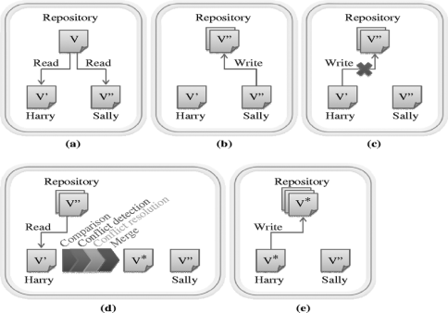
The
"Copy-Modify-Merge" Model

Slide 29
The Copy-Modify-Merge Model (1)
Andy and Bobby check-out the file A.
The check-out is done without locking.
Repository
A
Check-out
Check-out
A
A
Bobby
Andy

Slide 30
The Copy-Modify-Merge Model (2)
Both of them edit the local copies of the file (in the same time).
Repository
A
Bobby
Andy
(Local Edit)
(Local Edit)
Bobby
Andy

Slide 31
The Copy-Modify-Merge Model (3)
Bobby commits her changes to the repository.
Repository
Bobby
Commit
Bobby
Andy
Bobby
Andy

Slide 32
The Copy-Modify-Merge Model (4)
Andy tries to commit his changes.
A version conflict occurs.
Repository
Bobby
Commit
Bobby
Andy
(Local Conflict)
Bobby
Andy

Slide 33
The Copy-Modify-Merge Model (5)
Andy updates his changes with the ones from the repository.
The changes merge into his local copy.
A merge conflict can occur.
Repository
Bobby
Update
(with merge)
Bobby
Andy
&
Bobby
(Local Merge)
Bobby
Andy

Slide 34
The Copy-Modify-Merge Model (6)
Andy commits the changes to the repository.
A common version with the changes of Andy and Bobby is inserted.
Repository
Andy
&
Bobby
Commit
Bobby
Andy
&
Bobby
Bobby
Andy

Slide 35
The Copy-Modify-Merge Model (7)
Bobby updates the changes from the repository.
She gets the common version with the changes of Andy and Bobby.
Repository
Andy
&
Bobby
Update
Andy
&
Bobby
Andy
&
Bobby
Bobby
Andy

Slide 36
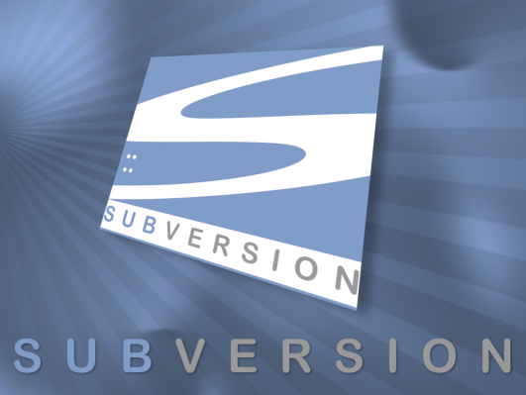
Subversion
Using Subversion and TortoiseSVN

Slide 37
Subversion
Subversion (SVN)
  Open source SCM repository
  http://subversion.tigris.org/
  Runs on UNIX, Linux, Windows
Console client
  svn
GUI client
  TortoiseSVN – http://tortoisesvn.tigris.org/
Visual Studio / Eclipse plug-ins

Slide 38
Subversion – Features
Versioning of the directory structure
Complete change log
  Deletion of files and directories
  Renaming of files and directories
  Saving of files or directories
Can work on it’s own or integrated with Apache as a module
Works effectively with tags and branching

Slide 39
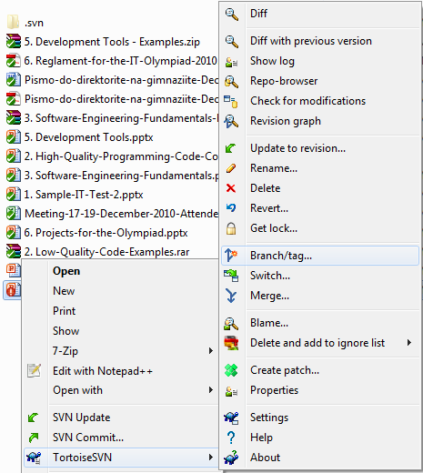
TortoiseSVN
TortoiseSVN
  Open source GUI client for Subversion
  Integrated in Windows Explorer
  http://tortoisesvn.tigris.org/

Slide 40



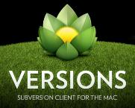
Subversion & TortoiseSVN
Live Demo

Slide 41

Project Hosting and Team Collaboration Sites
SourceForge, Google Code, CodePlex, Project Locker

Slide 42
Project Hosting Sites
SourceForge – http://www.sourceforge.net
  Source control (SVN, Git, …), web hosting, tracker, wiki, blog, mailing lists, file release, statistics, etc.
  Free, all projects are public and open source
Google Code – http://code.google.com/projecthosting/
  Source control (SVN), file release, wiki, tracker
    Very simple, basic functions only, not feature-rich
  Free, all projects are public and open source
  1-minute signup, without heavy approval process

Slide 43
Project Hosting Sites (2)
CodePlex – http://www.codeplex.com
  Microsoft's open source projects site
  Team Foundation Server (TFS) infrastructure
  Source control (TFS), issue tracker, downloads, discussions, wiki, etc.
  Free, all projects are public and open source
Project Locker – http://www.projectlocker.com
    Source control (SVN), TRAC, CI system, wiki, etc.
    Private projects (not open source)
    Free and paid editions

Slide 44
Project Hosting Sites (3)
Assembla – http://www.assembla.com
  Source control (SVN, Git), issue tracker, wiki, chats, files, messages, time tracking, etc.
  Private / public projects, free and paid editions
Bitbucket – http://bitbucket.org
  Source control (Mercurial), issue tracker, wiki, management tools
  Private projects, free and paid editions
Others: Github, Unfuddle, XP-Dev, Beanstalk

Slide 45

Google Code
Live Demo

Slide 46



Software Configuration Management (SCM)
Questions?

