Slide 1


High-Quality Programming Code Construction
Autumn Conference of the Bulgarian Oracle User Group (BGOUG), Pravetz, 19-Nov-2010
(for Java Developers)
Revealing the Secrets of Self-Documenting Code
Svetlin Nakov
Telerik Corporation
www.telerik.com

Slide 2
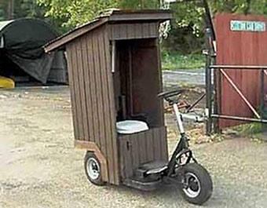
Happy World Toilet Day
19 November – World Toilet Day
Organized by the World Toilet Organization

Slide 3

Table of Contents
What is High-Quality Programming Code?
Naming Identifiers
Code Formatting
High-Quality Classes
High-Quality Methods
Using Variables, Expressions, Constants, Loops and Conditional Statements Correctly
Defensive Programming
Comments and Documentation

Slide 4


What is High-Quality Programming Code?

Slide 5

Why the Code Quality Is Important?
public static void main(String[
]args) {
int value= 010,i =5, w;
switch ( value){ case 10:w=5;System.out.println(w);break;case 9:i=0;break;
case 8:System.out. println("8 " );break;
default :System.out.println("def ") ;{
System .out.println("hoho ") ;}
for( int k =0 ;k < i ;k++,System. out
. println(k - 'f'));break;} {System
. out.println("loop!"); }}
What does this code do? Is it correct?

Slide 6

Why the Code Quality Is Important? (2)
public static void main(String[] args) {
int value = 010, i = 5, w;
switch (value) {
case 10:
w = 5; System.out.println(w); break;
case 9:
i = 0; break;
case 8:
System.out.println("8 "); break;
default:
System.out.println("def ");
System.out.println("hoho ");
for (int k = 0; k < i; k++, System.out.println(k - 'f'));
break;
}
System.out.println("loop!");
}
Now the code is formatted, but is still unclear.

Slide 7


What is High-Quality Programming Code?
High-quality programming code:
  Easy to read and understand
    Easy to modify and maintain
  Correct behavior in all cases
    Well tested
  Well architectured and designed
  Well documented
    Self-documenting code
  Well formatted

Slide 8

Naming Identifiers
Naming Classes, Interfaces, Enumerations, Methods, Variables and Constants

Slide 9

Use Meaningful Names
Always prefer using meaningful names
  Names should answer these questions:
    What does this class do? What is the intent of this variable? What is this variable / class used for?
  Examples:
    FactorialCalculator, studentsCount, Math.PI, configFileName, createReport
  Incorrect examples:
    k, k2, k3, junk, f33, KJJ, button1, variable, temp, tmp, temp_var, something, someValue

Slide 10

General Naming Guidelines
Always use English
  How you will feel if you read Vietnamese code with variables named in Vietnamese?
  English is the only language that all software developers speak
Avoid abbreviations
  Example: scrpCnt vs. scriptsCount
Avoid hard-to-pronounce names
  Example: dtbgRegExPtrn vs. dateTimeBulgarianRegExPattern

Slide 11

The Length of Names
How long could be the name of a class / struct / interface / enum / method?
  The name should be as long as required
  Don't abbreviate the names if this could make them unclear
  Your IDE has autocomplete, right?
Examples: FileNotFoundException, CustomerSupportNotificationService
Incorrect examples: FNFException, CustSuppNotifSrvc

Slide 12

Naming Methods
Methods naming guidelines
  Method names should be meaningful
  Should answer the question:
    What does this method do?
  If you cannot find a good name for a method, think about does it have clear intent
  Use camelCase
Examples: findStudent, loadReport, sinus
Incorrect examples: method1, doSomething, handleStuff, sampleMethod, dirtyHack

Slide 13
Single Purpose of All Methods
Methods should always have a single purpose!
  Otherwise they cannot be named well
  How to name a method that creates annual incomes report, downloads updates from internet and scans the system for viruses?
  createAnnualIncomesReportDownloadUpdatesAndScanForViruses is a nice name, right?
Methods that have multiple purposes (weak cohesion) are hard to be named
  Need to be refactored instead of named

Slide 14

Naming Variables
Variable names
  Should be in camelCase
  Preferred form: [Noun] or [Adjective] + [Noun]
  Should explain the purpose of the variable
    If you can't find good name for a variable check if it has a single purpose
    Exception: variables with very small scope, e.g. the index variable in a 3-lines long for-loop
  Names should be consistent in the project

Slide 15

Naming Variables – Example
Examples:
  firstName, report, usersList , fontSize, maxSpeed, font, startIndex, endIndex, charsCount, configSettingsXml, config, dbConnection, createUserSqlCommand
Incorrect examples:
  foo, bar, p, p1, p2, populate, LastName, last_name, LAST_NAME, no_convertImage, MAXSpeed, _firstName, temp, temp2, _temp, firstNameMiddleNameAndLastName

Slide 16
Temporary Variables
Do really temporary variables exist?
  All variables in a program are temporary because they are used temporarily only during the program execution, right?
Temporary variables can always be named better than temp or tmp:
// Swap a[i] and a[j]
int temp = a[i];
a[i] = a[j];
a[j] = temp;
// Swap a[i] and a[j]
int oldValue = a[i];
a[i] = a[j];
a[j] = oldValue;

Slide 17
The Length of Variable Names
How long could be the name of a variable?
  Depends on the variable scope and lifetime
  More "famous" variables should have longer and more self-explaining name
Acceptable naming examples:
Unacceptable naming examples:
for (int i=0; i<users.length; i++)
if (i % 2 == 0)
sum += users[i].getWeight();
class Student {
public String lastName;
}
class PairOfLists {
private int count;
}
class Student {
private int i;
}

Slide 18

Naming Constants
Use CAPITAL_LETTERS for final fields
Use meaningful names that describe their value
Examples:
Incorrect examples:
private static final int READ_BUFFER_SIZE = 8192;
public static final PageSize DEFAULT_PAGE_SIZE = PageSize.A4;
private static final int FONT_SIZE_IN_POINTS = 16;
public static final int MAX = 512; // Max what? Apples or Oranges?
public static final int BUF256 = 256; // What about BUF256 = 1024?
public static final String GREATER = "&gt;"; //GREATER_HTML_ENTITY
public static final int FONT_SIZE = 16; // 16pt or 16px?
public static final PageSize PAGE = PageSize.A4; // PAGE_SIZE

Slide 19


Code Formatting

Slide 20
Why Code Needs Formatting?
import java.io.FileInputStream;import java .io.
FileOutputStream;import java.io.IOException;import java
.io.InputStream;import java.io . OutputStream;public
class Test{public static void copyFileWithBuffer(
String sourceFileName ,String destFileName )throws
IOException{InputStream inputStream=new FileInputStream
(sourceFileName );try{ OutputStream outputStream
= new FileOutputStream(destFileName);try {byte [
] buffer = new byte[64* 1024] ;int bytesRead ;while
((bytesRead=inputStream .read( buffer)) !=-1
){outputStream.write(buffer,0,bytesRead ) ;}}finally {
outputStream.close();}}finally {inputStream.close();}}}

Slide 21

Code Formatting Fundamentals
Good formatting goals
  To improve code readability
  To improve code maintainability
Fundamental principle of code formatting:
  Any formatting style that follows the above principle is good
    Any other formatting is not good
The formating of the source code should disclose its logical structure.

Slide 22
Methods and Blocks Indentation
Methods should be indented with a single [Tab] from the class body
Methods body should be indented with a single [Tab] as well
public class IndentationExample {
private int Zero() {
return 0;
}
}
The entire method is indented with a single [Tab]
Method body is also indented

Slide 23

Good and Bad Formatting
Example:
Incorrect examples:
for (int i=0; i<10; i++) {
System.out.println("i=" + i);
}
for (int i=0; i<10; i++)
System.out.println("i=" + i);
for (int i=0; i<10; i++) System.out.println("i=" + i);
for (int i=0; i<10; i++)
{
System.out.println("i=" + i);
}

Slide 24

Breaking Long Lines
Break long lines after punctuation
Indent the second line by double [Tab]
Do not additionally indent the third line
Examples:
if (matrix[x, y] == 0 || matrix[x-1, y] == 0 ||
matrix[x+1, y] == 0 || matrix[x, y-1] == 0 ||
matrix[x, y+1] == 0) {
// Code comes here indented by a sinlge [Tab] …
DictionaryEntry<K, V> newEntry =
new DictionaryEntry<K, V>(
oldEntry.Key, oldEntry.Value);

Slide 25
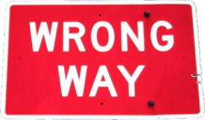
Incorrect Ways To Break
Long Lines
if (matrix[x, y] == 0 || matrix[x-1, y] ==
0 || matrix[x+1, y] == 0 || matrix[x,
y-1] == 0 || matrix[x, y+1] == 0) {
…
if (matrix[x, y] == 0 || matrix[x-1, y] == 0 ||
matrix[x+1, y] == 0 || matrix[x, y-1] == 0 ||
matrix[x, y+1] == 0) {
…
DictionaryEntry<K, V> newEntry
= new DictionaryEntry<K, V>(oldEntry
.Key, oldEntry.Value);

Slide 26

Code Alignment
All types of alignments are considered harmful
  Alignments are hard-to-maintain!
Incorrect examples:
Date date = new java.util.Date();
int count = 0;
Student student = new Student();
List<Student> students = new ArrayList<Student>();
matrix[x, y] == 0;
matrix[x + 1, y + 1] == 0;
matrix[2 * x + y, 2 * y + x] == 0;
matrix[x * y, x * y] == 0;

Slide 27
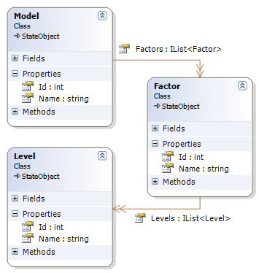
High-Quality Classes
How to Design High-Quality Classes? Abstraction, Cohesion and Coupling

Slide 28
High-Quality Classes: Abstraction
Present a consistent level of abstraction in the class contract (publicly visible members)
  What abstraction the class is implementing?
  Does it represent only one thing?
  Does the class name well describe its purpose?
  Does the class define clear and easy to understand public interface?
  Does the class hide all its implementation details?

Slide 29
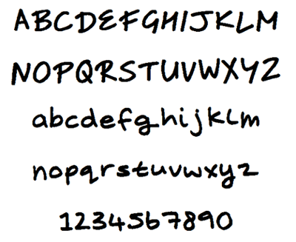
Good Abstraction – Example
public class Font {
public String name;
public float sizeInPoints;
public FontStyle style;
public Font(String name, float sizeInPoints, FontStyle style) {
this.setName(name);
this.setSizeInPoints(sizeInPoints);
this.setStyle(style);
}
…
public void drawString(DrawingSurface surface,
String str, int x, int y) { … }
public Size measureString(String str) { … }
}

Slide 30

Bad Abstraction – Example
Does this class really represent a "program"? Is this name good?
public class Program {
public String title;
public int size;
public Color color;
public void initializeCommandStack();
public void pushCommand(Command command);
public Command popCommand();
public void shutdownCommandStack();
public void initializeReportFormatting();
public void formatReport(Report report);
public void printReport(Report report);
public void initializeGlobalData();
public void shutdownGlobalData();
}
Does this class really have a single purpose?

Slide 31
Encapsulation
Minimize visibility of classes and members
  Start from private and move to package, protected and public if required
Classes should hide their implementation details
  A principle called encapsulation in OOP
  Anything which is not part of the class public interface should be declared private
Never declare fields public (except constants)
  Use methods or properties to access the fields

Slide 32


High-Quality Methods
How to Design and Implement High-Quality Methods? Understanding Cohesion and Coupling

Slide 33

Why We Need Methods?
Methods are important in software development
  Reduce complexity
    Divide and conquer: complex problems can be split into composition of several simple ones
  Improve code readability
    Small methods with good method names make the code self-documenting
  Avoid duplicating code
    Duplicating code is hard to maintain

Slide 34

Using Methods: Fundamentals
Fundamental principle of correct method usage:
Methods should do exactly what their names say
  Nothing less
  Nothing more
In case of incorrect input or incorrect preconditions, an exception should be raised
A method should do what its name says or should throw and exception. Any other behaviour is incorrect!

Slide 35

Good Methods – Examples
long sum(int[] elements) {
long sum = 0;
for (int element : elements) {
sum = sum + element;
}
return sum;
}
double calcTriangleArea(double a, double b, double c)
{
if (a <= 0 || b <= 0 || c <= 0) {
throw new IllegalArgumentException(
"Sides should be positive.");
}
double s = (a + b + c) / 2;
double area = Math.sqrt(s * (s - a) * (s - b) * (s - c));
return area;
}

Slide 36

Wrong Methods – Examples
long sum(int[] elements) {
long sum = 0;
for (int i = 0; i < elements.length; i++) {
sum = sum + elements[i];
elements[i] = 0;
}
return sum;
}
Hidden side effect. Don’t do this!
double calcTriangleArea(double a, double b, double c) {
if (a <= 0 || b <= 0 || c <= 0) {
return 0;
}
double s = (a + b + c) / 2;
double area = Math.sqrt(s * (s - a) * (s - b) * (s - c));
return area;
}
Incorrect result. Throw an exception instead!

Slide 37

Methods Length
How long should a method be?
  There is no specific restriction
  Avoid methods longer than one screen
    One screen ≈ 30-40 lines
  Cohesion and coupling are more important than the method length!
  Long methods are not always bad
    Be sure you have a good reason for their length

Slide 38


Defensive Programming
Handling Incorrect Input Correctly

Slide 39
Principles of Defensive Programming
Fundamental principle of defensive programming
Defensive programming means:
  To expect incorrect input and to handle it correctly
  To think not only about the usual execution flow, but to consider also unusual situations
  To ensure that incorrect input results to exception, not to incorrect output
Any public method should check its input data, preconditions and postconditions

Slide 40
Defensive Programming – Example
public String Substring(String str, int startIndex, int count)
{
if (str == null) {
throw new NullPointerException(“str is null.");
}
if (startIndex >= str.length()) {
throw new IllegalArgumentException(
"Invalid startIndex:" + startIndex);
}
if (startIndex + count > str.length()) {
throw new IllegalArgumentException(
"Invalid length:" + count);
}
…
Debug.assert(result.length() == count);
}
Check the input and preconditions.
Perform the method main logic.
Check the postconditions.

Slide 41

Exceptions – Best Practices
Choose a good name for your exception class
  Incorrect example:
  Example:
Use descriptive error messages
  Incorrect example:
  Example:
throw new Exception("File error!");
throw new FileNotFoundException("Cannot find file " + fileName);
throw new Exception("Error!");
throw new IllegalArgumentException("The speed should be " +
"between " + MIN_SPEED + " and " + MAX_SPEED + ".");

Slide 42


Coffee Break

Slide 43

Cohesion and Coupling

Slide 44
Strong Cohesion
Methods should have strong cohesion
  Should address single task and address it well
  Should have clear intent
Methods that address several tasks in the same time are hard to be named
Strong cohesion is used in engineering
  In computer hardware any PC component handles a single task
  E.g. hard disk performs a single task – storage

Slide 45




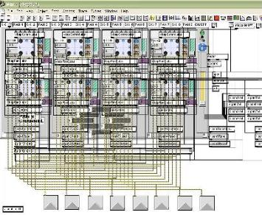
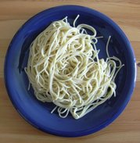
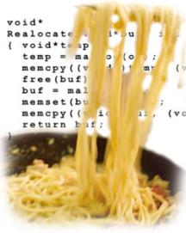
Strong and Weak Cohesion
  Strong cohesion: hard disk, CD-ROM, floppy
  Weak cohesion: spaghetti code

Slide 46
Strong Cohesion
Strong cohesion example:
  Class Math that has methods and constants:
    sin(), cos(), sqrt(), pow(), exp()
    Math.PI, Math.E
double sideA = 40, sideB = 69;
double angleAB = Math.PI / 3;
double sideC =
Math.pow(sideA, 2) + Math.pow(sideB, 2) -
2 * sideA * sideB * Math.cos(angleAB);
double sidesSqrtSum = Math.sqrt(sideA) +
Math.sqrt(sideB) + Math.sqrt(sideC);

Slide 47
Weak Cohesion
Example of weak cohesion
  Class Magic that has all these methods:
Another example:
public void printDocument(Document d);
public void sendEmail(String recipient, String subject, String text);
public void calculateDistanceBetweenPoints(int x1, int y1, int x2, int y2)
MagicClass.makePizza("Fat Pepperoni");
MagicClass.withdrawMoney("999e6");
MagicClass.openDBConnection();

Slide 48
Loose Coupling
What is loose coupling?
  Minimal dependences of the method on the other parts of the source code
  Minimal dependences on the class members or external classes and their members
  No side effects
  If the coupling is loose, we can easily reuse a method or group of methods in a new project
Tight coupling → spaghetti code

Slide 49
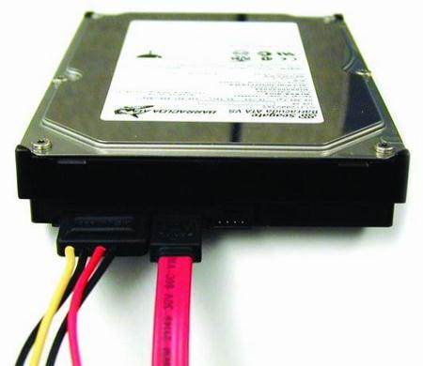
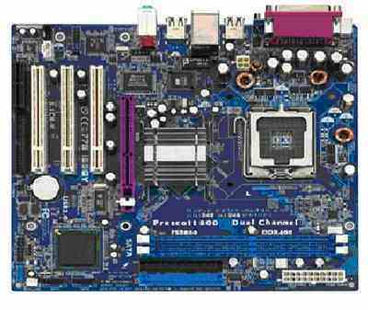
Loose and Tight Coupling
Loose Coupling:
  Easily replace old HDD
  Easily place this HDD to another motherboard
Tight Coupling:
  Where is the video card?
  Can you change the video card?

Slide 50
Loose Coupling – Example
class Report {
public bool loadFromFile(String fileName) {…}
public bool saveToFile(String fileName) {…}
}
class Printer {
public static int print(Report report) {…}
}
class LooseCouplingExample
{
public static void main(String[] args) {
Report myReport = new Report();
myReport.loadFromFile("C:\\DailyReport.rep");
Printer.print(myReport);
}
}

Slide 51

Tight Coupling – Example
Passing parameters through class fields
  Typical example of tight coupling
  Don't do this unless you have a good reason!
class Sumator
{
public int a, b;
private int sum() {
return a + b;
}
public static void main(String[] args) {
Sumator sumator = new Sumator();
sumator.a = 3;
sumator.b = 5;
System.out.println(sumator.sum());
}
}
Why don't pass the numbers as parameters?

Slide 52
Spaghetti Code
Combination of weak cohesion and tight coupling (spaghetti code):
class Report {
public void print() {…}
public void initPrinter() {…}
public void loadPrinterDriver(string fileName) {…}
public bool saveReport(string fileName) {…}
public void setPrinter(string printer) {…}
}
class Printer {
public void setFileName() {…}
public static boolean loadReport() {…}
public static boolean checkReport() {…}
}

Slide 53


Using Variables
Best Practices

Slide 54
Single Purpose
Variables should have single purpose
  Never use a single variable for multiple purposes!
  Economizing memory is not an excuse
Can you choose a good name for variable that is used for several purposes?
  Example: variable used to count students of to keep the average of their grades
  Proposed name: studentsCountOrAvgGrade

Slide 55
Retuning Result from a Method
Always assign the result of a method in some variable before returning it
  Improved code readability
    The returned value has self-documenting name
  Simplified debugging
  Example:
  Incorrect example:
The intent of the formula is obvious.
int salary = days * hoursPerDay * ratePerHour;
return salary;
We can put a breakpoint at this line and check the result for correctness.
return days * hoursPerDay * ratePerHour;

Slide 56
Variable Scope
Variable scope defines how "famous" is a variable in the program
  Static variables are more "famous" than instance variables, and they are more "famous" than local
  Variables' visibility is directly related to their scope
    public, protected, package, private
Always try to reduce the variable's scope
  This reduces potential coupling
  Avoid public fields (exception: constants)
  Access all fields through properties / methods

Slide 57

Exceeded Scope – Example
public class Globals {
public static int state = 0;
}
public class Genious {
public static void printSomething() {
if (Globals.state == 0) {
System.out.println("Hello.");
}
else {
System.out.println("Good bye.");
}
}
}

Slide 58
Variable Span and Lifetime
Variable span
  The average number of lines of code (LOC) between variable usages
Variable lifetime
  The number of lines of code (LOC) between the first and the last variable usage in a block
Keep variable span and lifetime as low as possible
Always define and initialize variables just before their first use and never before it!

Slide 59
Unneeded Large Variable Span and Lifetime
int count;
int[] nums = new int[100];
for (int i = 0; i < nums.length; i++) {
nums[i] = i;
}
count = 0;
for (int i = 0; i < nums.length / 2; i++) {
nums[i] = nums[i] * nums[i];
}
for (int i = 0; i < nums.length; i++) {
if (nums[i] % 3 == 0) {
count++;
}
}
System.out.println(count);
lifetime ("count") = 15
span =
15 / 4 =
3.75

Slide 60
Reduced Variable Span and Lifetime
int[] nums = new int[100];
for (int i = 0; i < nums.length; i++) {
nums[i] = i;
}
for (int i = 0; i < nums.length / 2; i++) {
nums[i] = nums[i] * nums[i];
}
int count = 0;
for (int i = 0; i < nums.length; i++) {
if (nums[i] % 3 == 0) {
count++;
}
}
System.out.println(count);
lifetime = 7
span=
7 / 3 = 2.33

Slide 61


Using Expressions
Best Practices

Slide 62
Avoid Complex Expressions
Never use complex expressions in the code!
  Incorrect example:
Complex expressions are evil because:
  Make code hard to read and understand, hard to debug, hard to modify and hard to maintain
What shall we do if we get at this line IndexOutOfBoundsException?
for (int i=0; i<xCoords.length; i++) {
for (int j=0; j<yCoords.length; j++) {
matrix[i][j] =
matrix[xCoords[findMax(i)+1]][yCoords[findMin(j)-1]] *
matrix[yCoords[findMax(j)+1]][xCoords[findMin(i)-1]];
}
}
There are 10 potential sources of IndexOutOfBoundsException in this expression!

Slide 63

Simplifying Complex Expressions
for (int i = 0; i < xCoords.length; i++) {
for (int j = 0; j < yCoords.length; j++) {
int maxStartIndex = findMax(i) + 1;
int minStartIndex = findMin(i) - 1;
int minXcoord = xCoords[minStartIndex];
int maxXcoord = xCoords[maxStartIndex];
int minYcoord = yCoords[minStartIndex];
int maxYcoord = yCoords[maxStartIndex];
int newValue =
matrix[maxXcoord][minYcoord] *
matrix[maxYcoord][minXcoord];
matrix[i][j] = newValue;
}
}

Slide 64

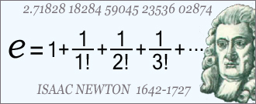
Using Constants
When and How to Use Constants?

Slide 65

Avoid Magic Numbers and Strings
What is magic number or value?
  Magic numbers / values are all literals different than 0, 1, -1, null and "" (empty string)
Avoid using magic numbers / values
  They are hard to maintain
    When change occurs, you need to modify all occurrences of the magic number / constant
  Their meaning is not obvious
    Example: what does the number 1024 mean?

Slide 66

The Evil Magic Numbers
public class GeometryUtils {
public static double calcCircleArea(double radius) {
double area = 3.14159206 * radius * radius;
return area;
}
public static double calcCirclePerimeter(double radius) {
double perimeter = 6.28318412 * radius;
return perimeter;
}
public static double calcElipseArea(
double axis1, double axis2) {
double area = 3.14159206 * axis1 * axis2;
return area;
}
}

Slide 67

Turning Magic
Numbers into Constants
public class GeometryUtils {
public static final double PI = 3.14159206;
public static double calcCircleArea(double radius) {
double area = PI * radius * radius;
return area;
}
public static double calcCirclePerimeter(double radius) {
double perimeter = 2 * PI * radius;
return perimeter;
}
public static double calcElipseArea(
double axis1, double axis2) {
double area = PI * axis1 * axis2;
return area;
}
}

Slide 68
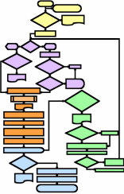

Using Control Constructs
Using Conditional Statements and Loops Correctly

Slide 69


Using Conditional Statements
Always use { and } for the conditional statements body, even when it is a single line:
Why omitting the brackets could be harmful?
  This is misleading code + misleading formatting
if (condition) {
doSometing();
}
if (condition)
doSomething();
doAnotherThing();
doDifferentThing();

Slide 70
Use Simple Conditions
Do not use complex if conditions
  You can always simplify them by introducing boolean variables or boolean methods
  Incorrect example:
  Complex boolean expressions are harmful
  How you will find the problem if you get IndexOutOfBoundseException?
if (x > 0 && y > 0 && x < width-1 && y < height-1 &&
matrix[x, y] == 0 && matrix[x-1, y] == 0 &&
matrix[x+1, y] == 0 && matrix[x, y-1] == 0 &&
matrix[x, y+1] == 0 && !visited[x, y]) { … }

Slide 71
Simplifying Boolean Conditions
The last example can be easily refactored into self-documenting code:
Now the code is:
  Easy to read – the logic of the condition is clear
  Easy to debug – breakpoint can be put at the if
boolean inRange =
x > 0 && y > 0 && x < width-1 && y < height-1;
boolean emptyCellAndNeighbours =
matrix[x, y] == 0 && matrix[x-1, y] == 0 &&
matrix[x+1, y] == 0 && matrix[x, y-1] == 0 &&
matrix[x, y+1] == 0;
if (inRange && emptyCellAndNeighbours && !visited[x, y])

Slide 72
Avoid Deep Nesting of Blocks
Deep nesting of conditional statements and loops makes the code unclear
  Deep nesting ≈ 3-4 or more levels of nesting
  Deeply nested code is complex and hard to read and understand
  Usually you can extract portions of the code in separate methods
    This simplifies the logic of the code
    Using good method name makes the code self-documenting

Slide 73

Deep Nesting – Example
if (maxElem != Integer.MAX_VALUE) {
if (arr[i] < arr[i + 1]) {
if (arr[i + 1] < arr[i + 2]) {
if (arr[i + 2] < arr[i + 3]) {
maxElem = arr[i + 3];
}
else {
maxElem = arr[i + 2];
}
}
else {
if (arr[i + 1] < arr[i + 3]) {
maxElem = arr[i + 3];
}
else {
maxElem = arr[i + 1];
}
}
}
(continues on the next slide)

Slide 74

Deep Nesting – Example (2)
else {
if (arr[i] < arr[i + 2]) {
if (arr[i + 2] < arr[i + 3]) {
maxElem = arr[i + 3];
}
else {
maxElem = arr[i + 2];
}
}
else {
if (arr[i] < arr[i + 3]) {
maxElem = arr[i + 3];
}
else {
maxElem = arr[i];
}
}
}
}

Slide 75

Avoiding Deep Nesting – Example
private static int max(int i, int j) {
if (i < j) {
return j;
}
else {
return i;
}
}
private static int max(int i, int j, int k) {
if (i < j) {
int maxElem = max(j, k);
return maxElem;
}
else {
int maxElem = max(i, k);
return maxElem;
}
}
(continues on the next slide)

Slide 76

Avoiding Deep Nesting – Example
private static int findMax(int[] arr, int i) {
if (arr[i] < arr[i + 1]) {
int maxElem =
max(arr[i + 1], arr[i + 2], arr[i + 3]);
return maxElem;
}
else {
int maxElem = Max(arr[i], arr[i + 2], arr[i + 3]);
return maxElem;
}
}
…
if (maxElem != Integer.MAX_VALUE) {
maxElem = FindMax(arr, i);
}

Slide 77

Comments and Code Documentation
The Concept of Self-Documenting Code

Slide 78
Self-Documenting Code
Effective comments do not repeat the code
  They explain it at higher level and reveal non-obvious details
Self-documenting code fundamental principles
The best documentation is the code itself.
Make the code self-explainable and self-documenting, easy-to-read and understand.
Do not document bad code, rewrite it!

Slide 79

Bad Comments – Example
public static List<Integer> findPrimes(int start, int end) {
// Create new list of integers
List<Integer> primesList = new ArrayList<Integer>();
// Perform a loop from start to end
for (int num = start; num <= end; num++) {
// Declare boolean variable, initially true
boolean prime = true;
// Perform loop from 2 to sqrt(num)
for (int div = 2; div <= Math.sqrt(num); div++) {
// Check if div divides num with no remainder
if (num % div == 0) {
// We found a divider -> the number is not prime
prime = false;
// Exit from the loop
break;
}
// Continue with the next loop value
}
(continues on the next slide)

Slide 80

Bad Comments – Example (2)
// Check if the number is prime
if (prime) {
// Add the number to the list of primes
primesList.add(num);
}
}
// Return the list of primes
return primesList;
}

Slide 81

Self-Documenting Code – Example
public static List<Integer> findPrimes(
int start, int end) {
List<Integer> primesList = new ArrayList<Integer>();
for (int num = start; num <= end; num++) {
boolean isPrime = isPrime(num);
if (isPrime) {
primesList.add(num);
}
}
return primesList;
}
Good code does not need comments. It is self-explaining.
(continues on the next slide)

Slide 82

Self-Documenting Code – Example (2)
private static boolean isPrime(int num) {
boolean isPrime = true;
int maxDivider = (int) Math.sqrt(num);
for (int div = 2; div <= maxDivider; div++) {
if (num % div == 0) {
// Found a divider -> the number is not prime
isPrime = false;
break;
}
}
return isPrime;
}
This comment explain non-obvious details. It does not repeat the code.
Good methods have good name and are easy to read and understand.

Slide 83

Good Comments
Good Comments are Always Built-In the Code!

Slide 84

Resources
The "High-quality programming code construction" course at Telerik Academy:
  http://codecourse.telerik.com
The bible of high-quality software construction:
Code Complete, 2nd edition, Steve McConnell, Microsoft Press, 2004, ISBN 0735619670, http://www.cc2e.com

Slide 85




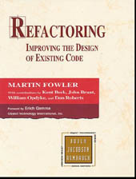

High-Quality Programming Code Construction (for Java)
?
?
?
?
?

