Slide 1
Telerik Academy
http://academy.telerik.com
Free Training Courses for .NET Software Engineers
Svetlin Nakov
Telerik Corporation
www.telerik.com

Slide 2
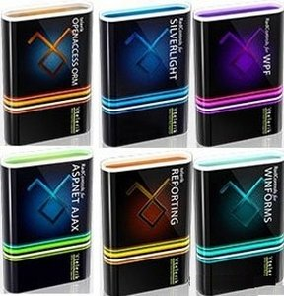
About Telerik
What Makes Telerik so Successful?

Slide 3
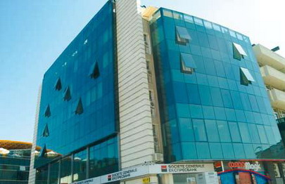
About Telerik
What Telerik does?
Leading vendor of ASP.NET AJAX, Silverlight, WPF and Windows Forms components, ORM, Reporting, and CMS solutions and VS Plugins
Headquartered in Bulgaria
With offices in Boston, Munich and Austin
About 200 employees – mostly developers
Employer #1 in Bulgaria for 2007
Microsoft Gold Certified Partner

Slide 4
Telerik Academy
Free Trainings for .NET Software Engineers

Slide 5
Telerik Academy – Objectives
Train young people in software engineering with the .NET technologies (free of charge)
Practical training with lots of practice
Cutting edge technologies from Microsoft
Software engineering skills
Supplement the University education
Hire the best students in the Telerik development teams
Support the IT industry development

Slide 6
Telerik Academy Learning Track
2 months,
4 hours/day
Fundamentals of C# Programming
(Part I and Part II)
96 people (I)
48 people (II)
3 months,
full time
.NET Development Essentials
20 people
1 month,
full time
15-20
people
Advanced ASP.NET & AJAX Development
Advanced Silverlight and WPF Development
Data-Centric Development
Advanced Windows Forms Development

Slide 7
Learning & Filtering Process
Candidates apply for participation in the program
Intermediate exam & filtering
Final exam, filtering and interview
Internal approval process
“Fundamentals of C# Programming” course (part I)
“Fundamentals of C# Programming” course (part II)
“.NET Development Essentials” course
Exams and filtering
ASP.NET, Silverlight and WPF, WinForms and Data-Centric Dev
Exams, filtering, interviews, etc.
Joining in one of the Telerik development teams

Slide 8
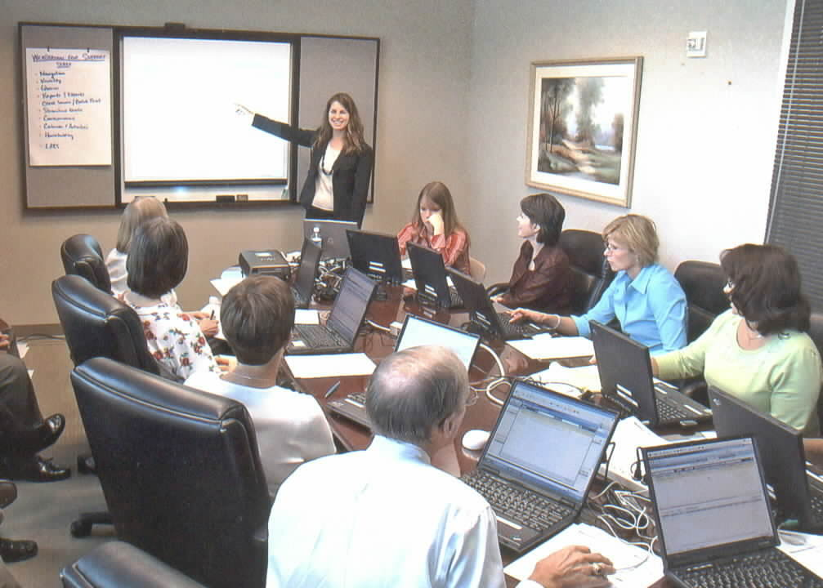
The Training Courses
C# Fundamentals, .NET Essentials, ASP.NET & AJAX, WPF, Silverlight, Windows Forms, Data-Centric

Slide 9
Fundamentals of C# Programming
Fundamentals computer programming skills
Part I – 1 month, 6 groups x 16 students
Data Types, variables, operators, expressions, statements, console input / output, numeral systems, loops, arrays, methods
Part II – 1 month, 2 groups x 18 students
Recursion, object-oriented programming, classes and objects, exceptions, strings, text files, data structures (lists, trees, graphs, hash-tables, sets), algorithms and complexity, problems solving, high-quality code

Slide 10
.NET Development Essentials
.NET Essentials – 3 months, 8 hours/day, 20 stud.
.NET Framework 4.0, advanced OOP techniques, common type system, regular expressions, streams
Databases, data modeling, SQL, MS SQL Server, LINQ, ADO.NET, LINQ-to-SQL, XML
GUI applications and Windows Forms
Web programming, HTML, CSS, JavaScript, ASP.NET, AJAX
WPF, XAML, Silverlight, RIA applications
Software engineering, design patterns, etc.

Slide 11
Specialized Courses
Specialized technological courses – 1 month practice, full time
Advanced ASP.NET and AJAX Development
Advanced Windows Forms Development
Advanced WPF and Silverlight Development
Data-Centric Development for .NET
Practical projects
Working in teams on common project under the trainer's supervision

Slide 12
Requirements for All Trainees
The Training Program Requires 100% Commitment!

Slide 13
Requirements for All Trainees
Basic computer skills
We don’t teach computer literacy
English
Ability to read technical documentation in English is enough
Long-term commitment
8 hours / day (average)

Slide 14
Invest in Yourself!
Invest in yourself!
Invest in your training!
Invest in your skills development!
… Unless you consider yourself a bad investment. Do you?

Slide 15
How to Apply?
To apply for Telerik Academy program, visit:
http://academy.telerik.com
Required documents:
CV
Cover letter
Diplomas, certificates, etc.
Next season: August 2010

Slide 16
IT Olympiad Trainings
Training for the Bulgarian IT Olympiad from Telerik Academy
Preparation for the IT test
Guidance and mentoring about the projects
Software architecture, technologies, best practices
High-quality code, secure code, etc.
IT Olympiads in Google Groups
http://groups.google.bg/group/it-olymp

Slide 17
Telerik Academy
?
?
?
?
?
Questions?
?
?
?
?
?
http://academy.telerik.com

Slide 18
Question for T-Shirt
What is SQL
Injection?

Slide 19
Question for T-Shirt
What is CLR?

Slide 20
Question for T-Shirt
What is FireBug?

Slide 21
Question for T-Shirt
What are the most widespread RIA platforms?

Slide 22
Question for T-Shirt
What is XAML?

Slide 23
Question for T-Shirt
What is "static class"?

Slide 24
Question for T-Shirt
What is database constraint?

